Slide 1
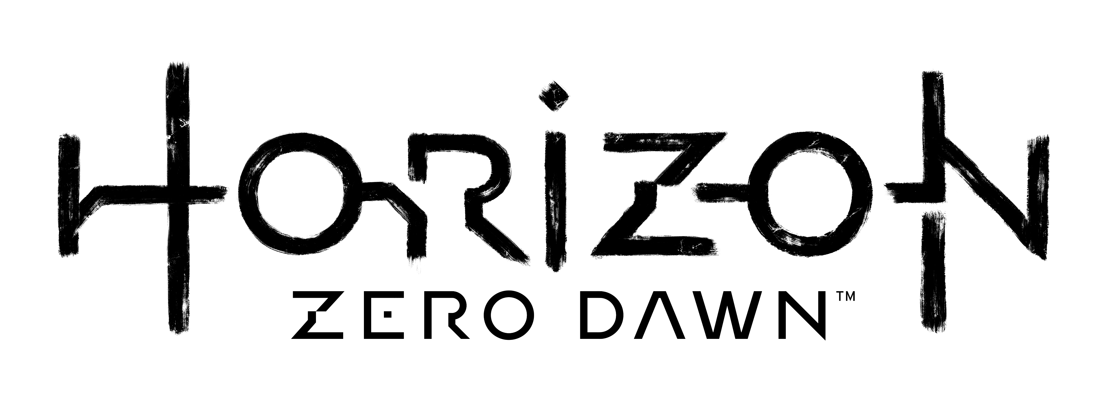

Bandit Camp Design
By Roberto Padrón

Slide 2


Level Design: Ring Concept
I designed this concept to create a modular set of gameplay experiences in order to quick and easy, have different gameplay approaches before getting into the actual design of the level, saving time of production and helping designers to set the gameplay basis for their blockouts.
As this is an open word game, we need to design the area for a 360 approach stablishing some rules:
We defined different set of gameplay area rings considering:
  Difficulty
  Gameplay style
This rings can be subdivided to add variety to the gameplay concept.
A
P
P
Active: aggressive style
Passive: stealth style
1.
Easy
Normal
Hard
Safe zone
A
P
P
A
2.
P
P
A
A
P

Slide 3



Level Design: Ring Concept
We place them in layers, so the player can feel his progressing when entering in the area.
This layers can communicate between each other with navigation arrows to define the areas where the player is able to move and progress.
A
P
A
A
P
P
4.
A
3.
A
A
P
P
P

Slide 4
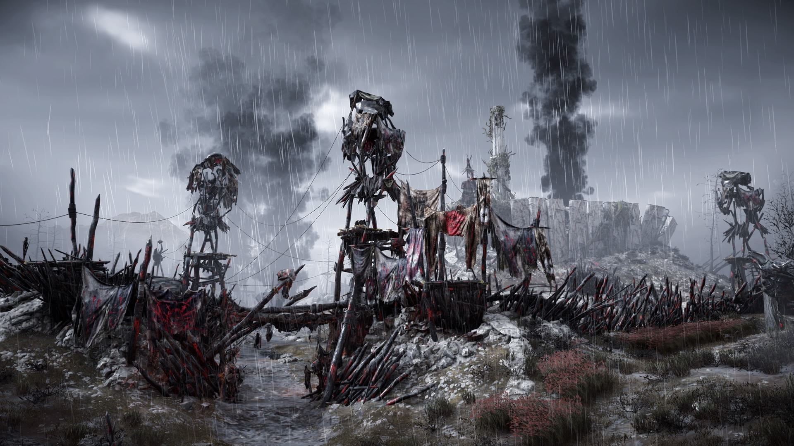
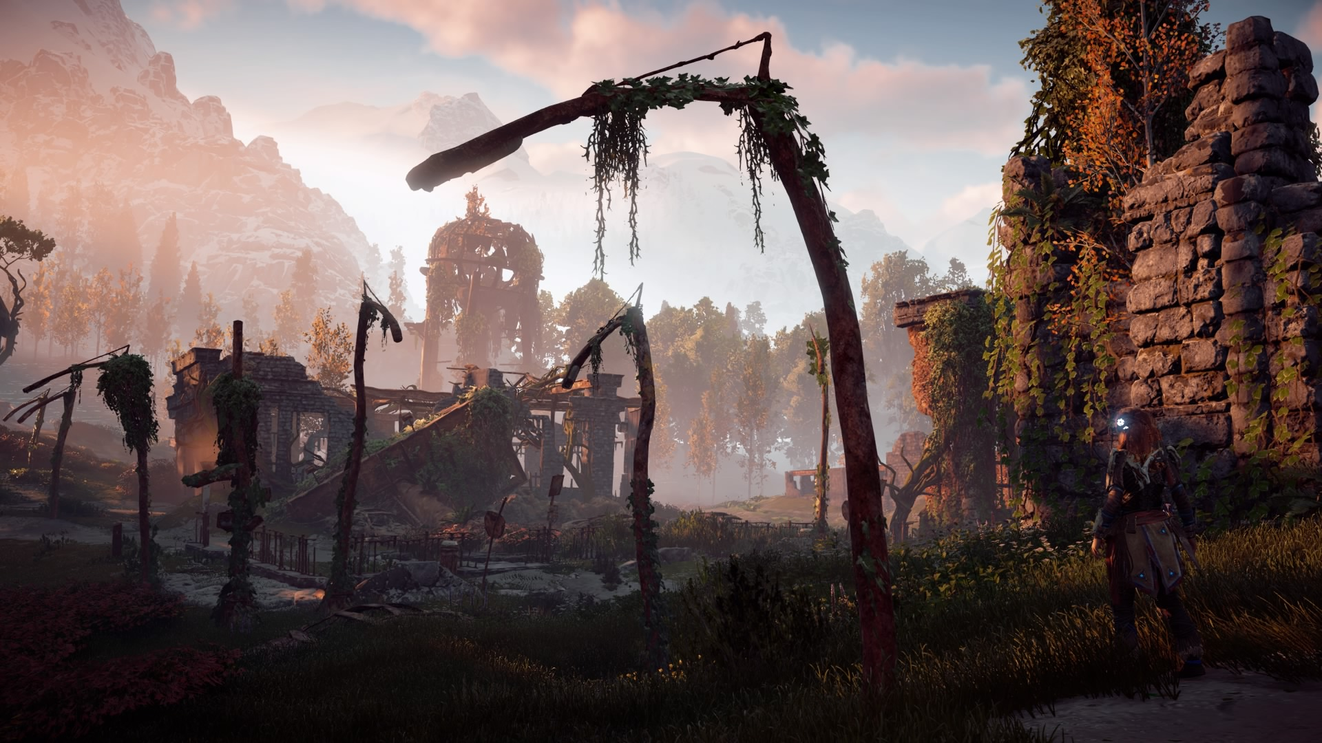
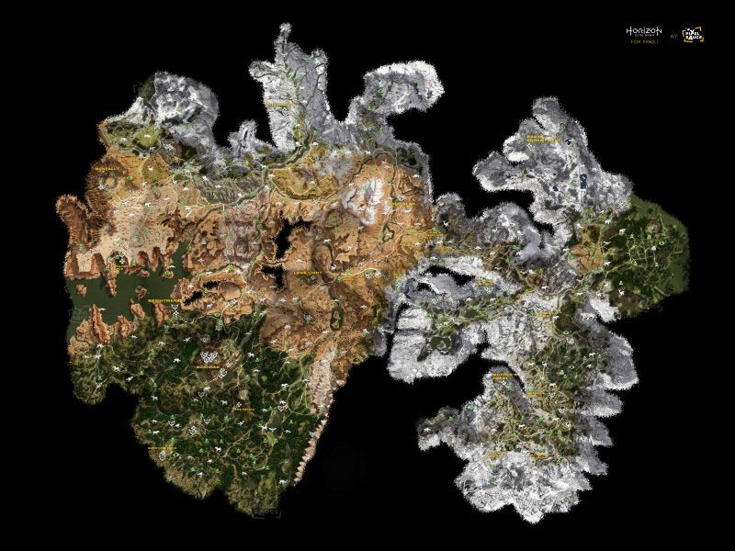
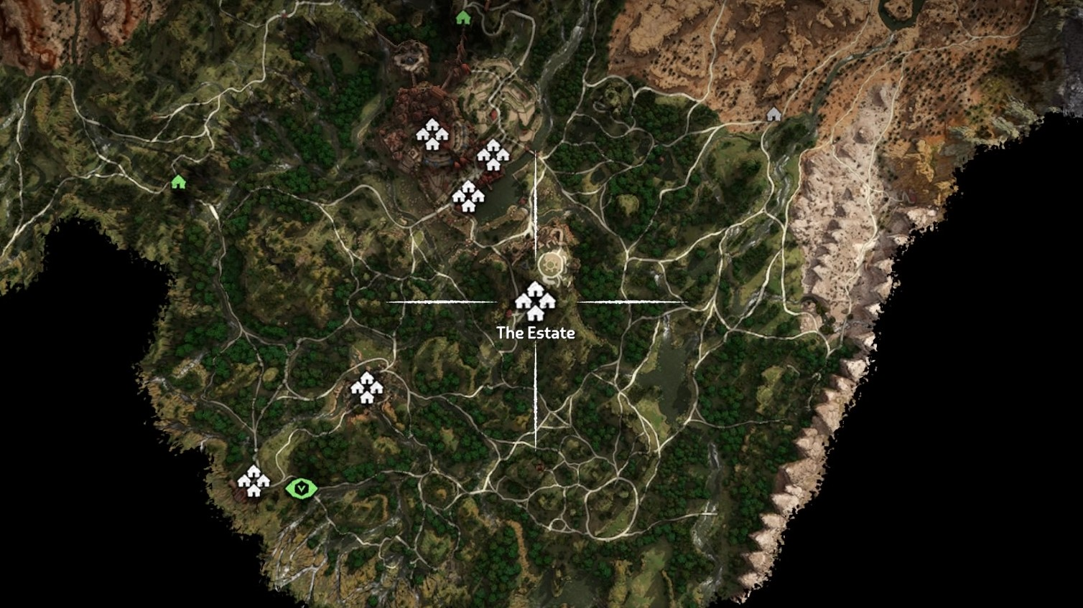

High Level Concept
Name: “Ancient Ruins Bandit Camp”
Level: 13
POI (Point of Interest): Destroyed/Abandoned ancient city
Gameplay type: Activity
Location: The Jewel
Enemies: Bandits
Reward: 7000 xp (placeholder value)

Slide 5
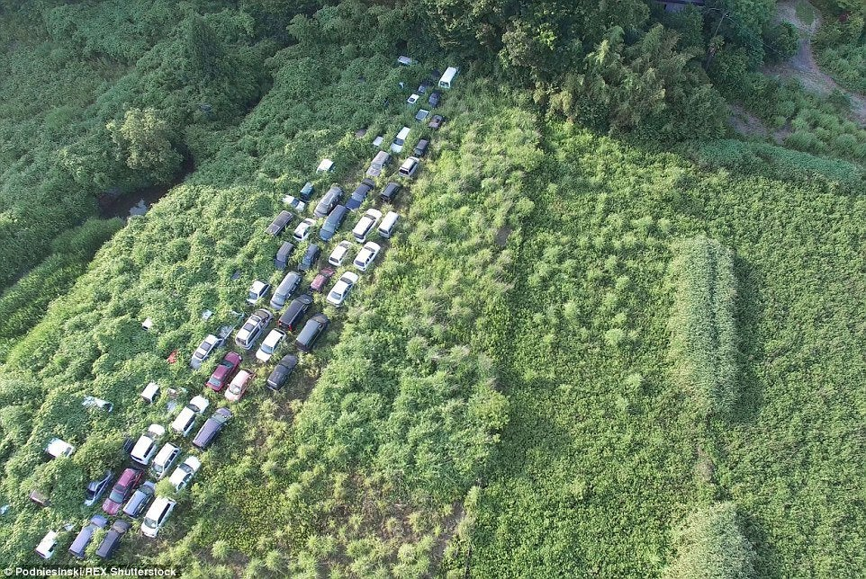
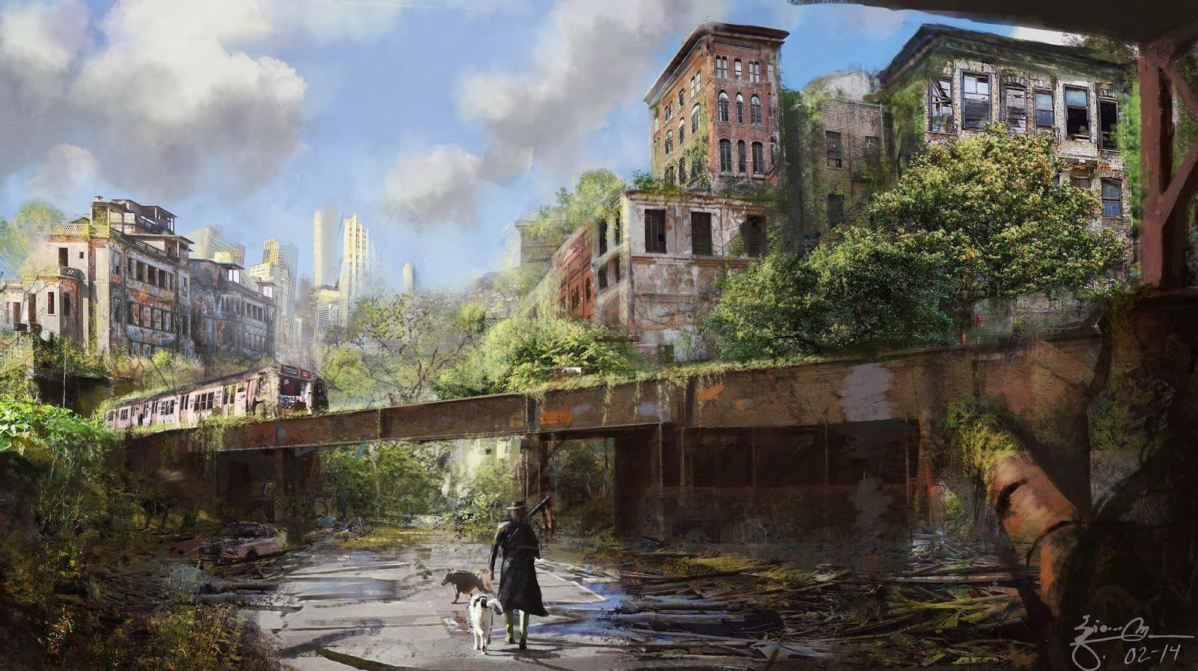
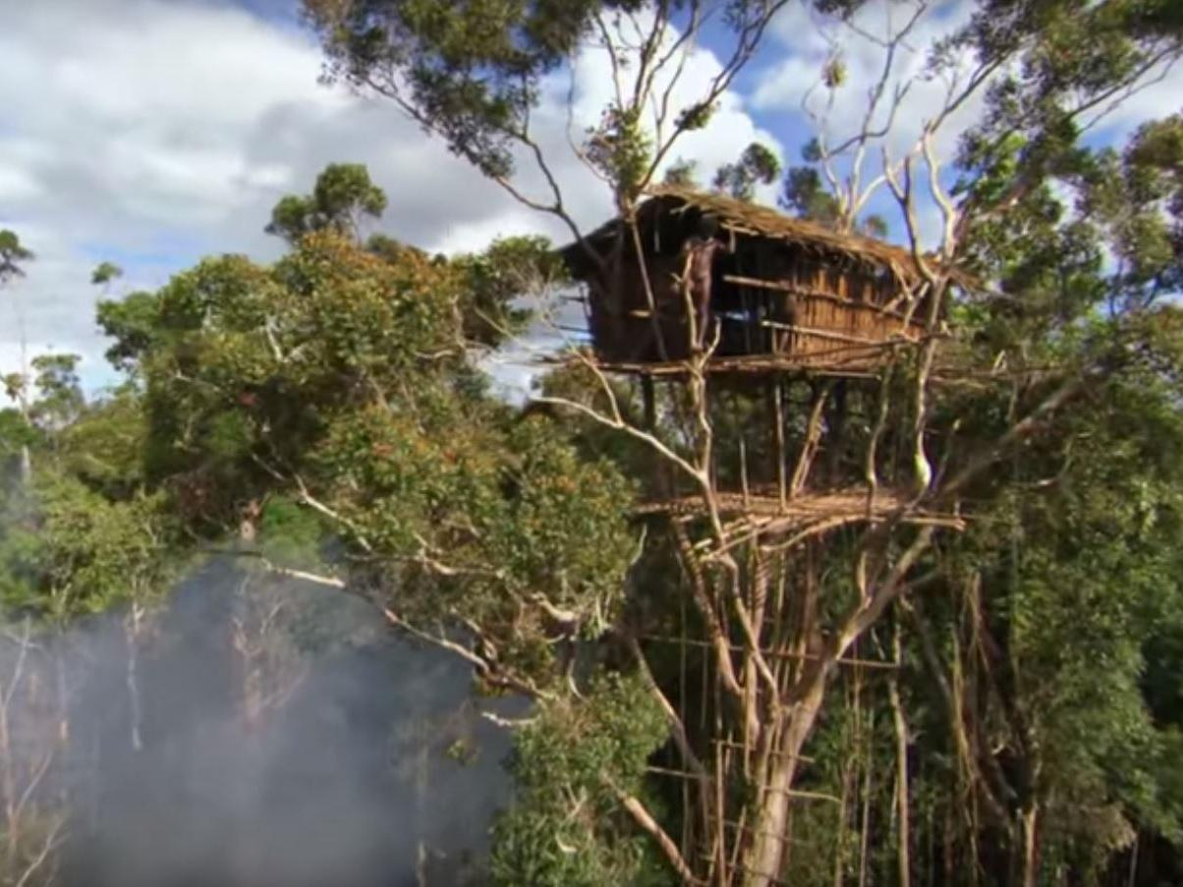
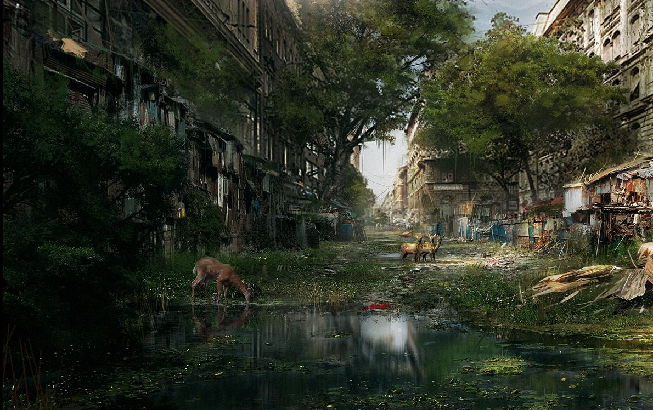
References

Slide 6
Ring Design
1st iteration:
From a 360 approach in the safe zone, the player is able to see the bandit camp surroundings and analyze the game space in order the create a combat strategy and decide how to approach to the enemy area.
Player will encounter 2 active-normal areas and 2 passive-easy areas.
In the center the player will find an active-hard area and a passive-hard area.
Added the first navigation arrows to navigate between areas, that will be improved in the Blockout.
P
A
P
A
A
P
A

Slide 7
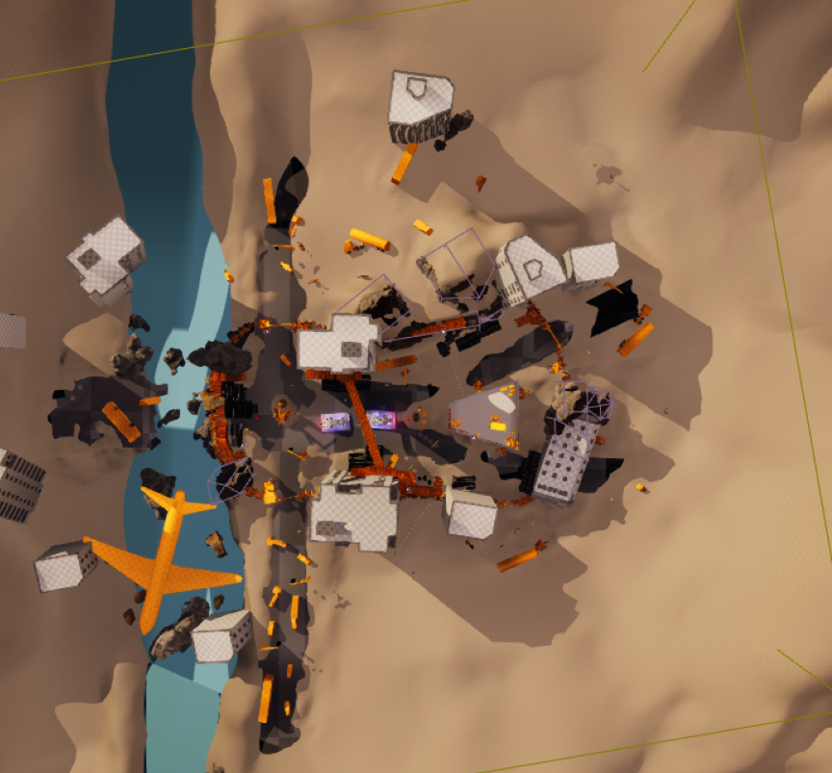
Ring Design
P
P
A
A
P
A
A
A
P
A
P
P
A
A

Slide 8
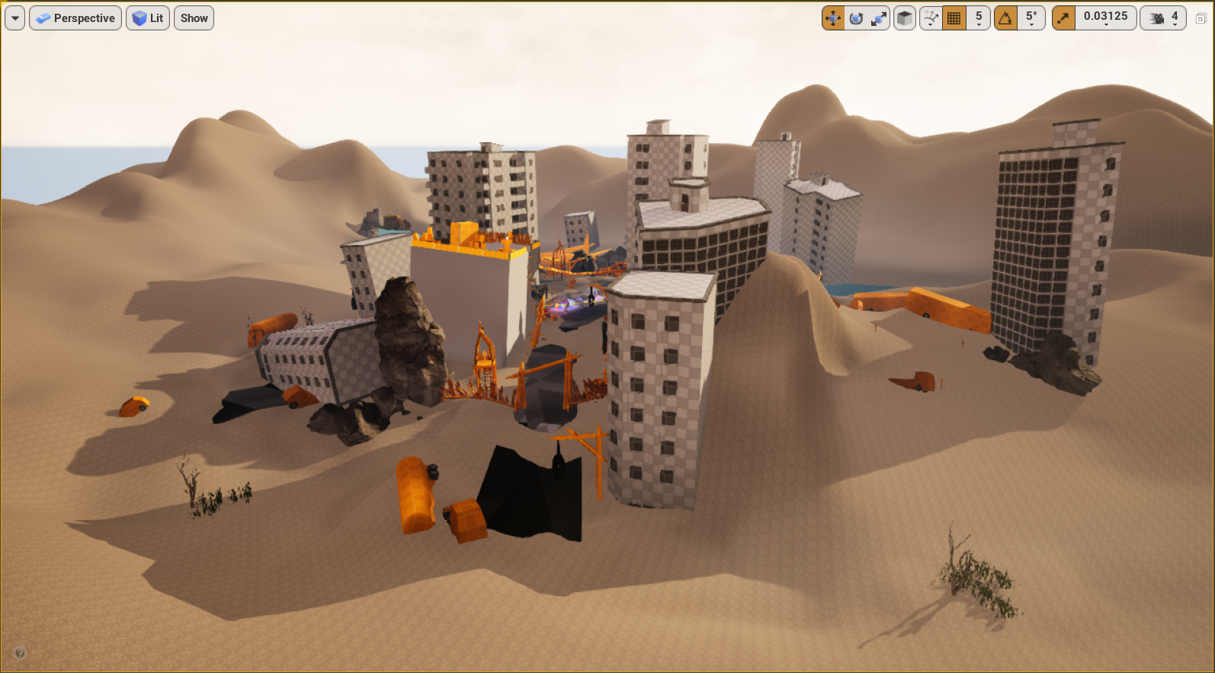
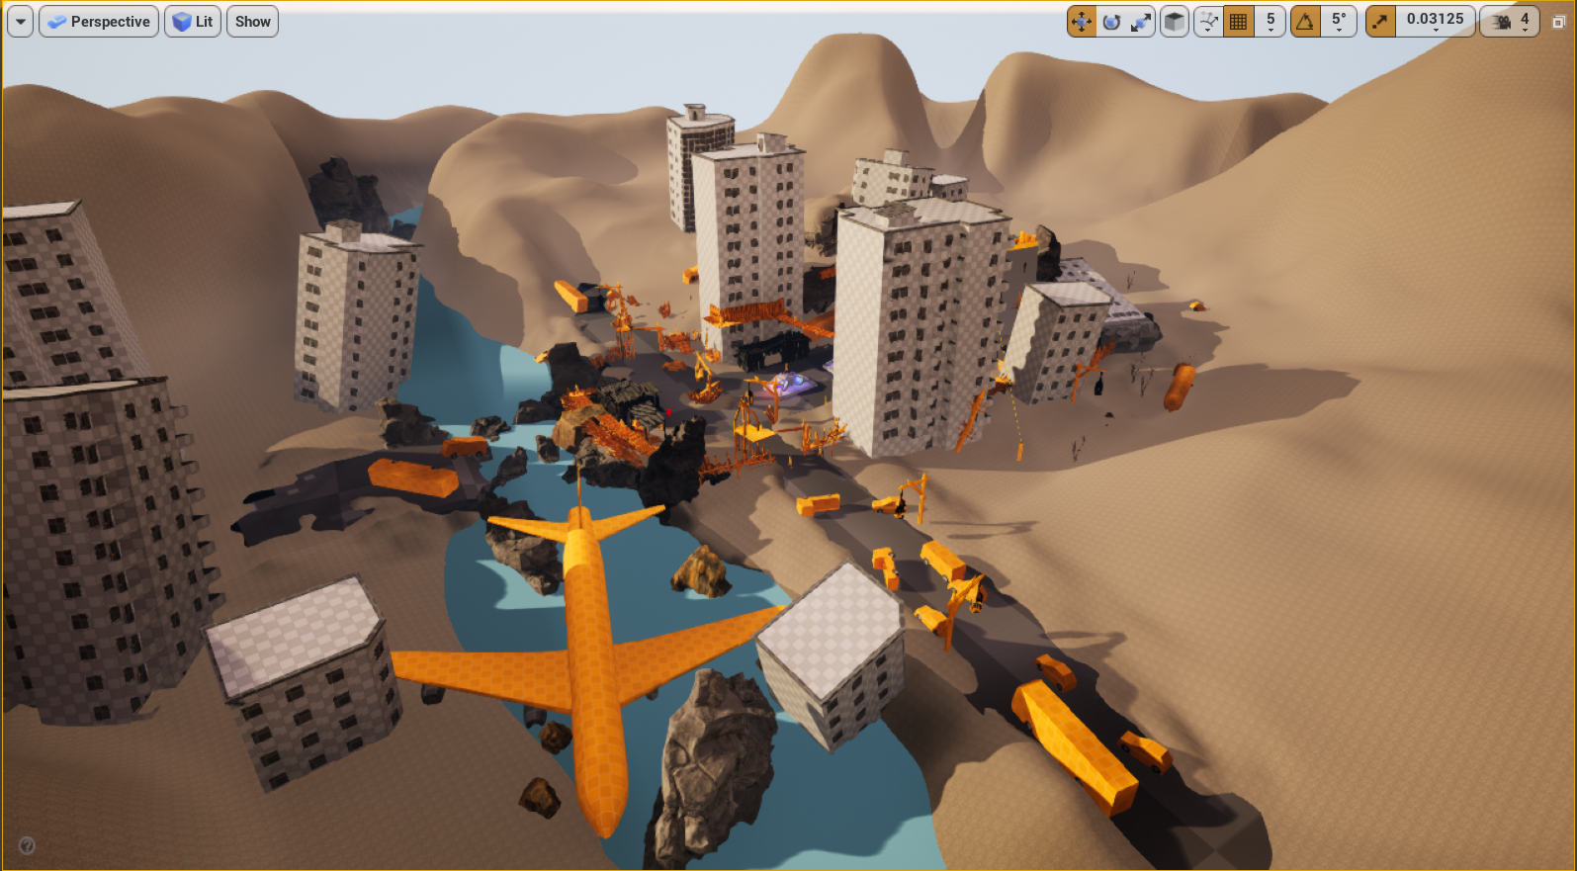
POI (Point of Interest)
The POI of the level is created in order to attract the player when his navigating through the world, something that is uncommon to find out and engage players to explore. In this case an almost intact abandoned city.

Slide 9
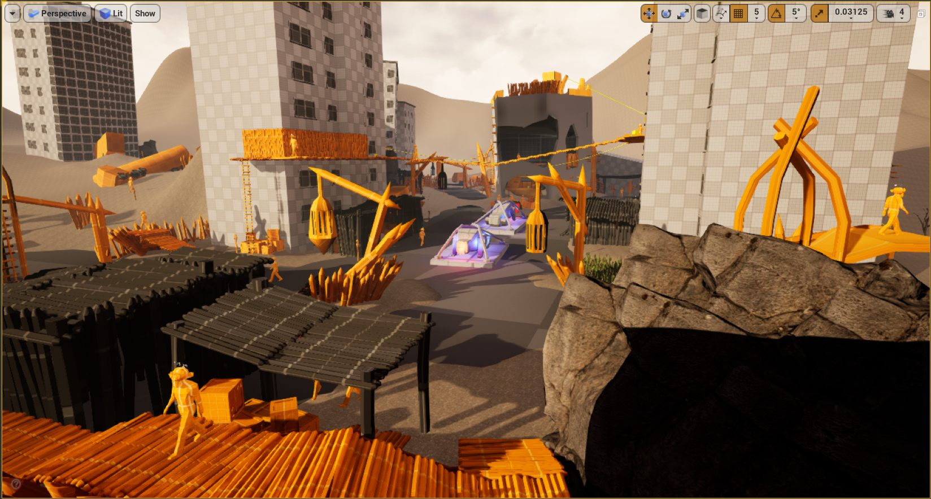
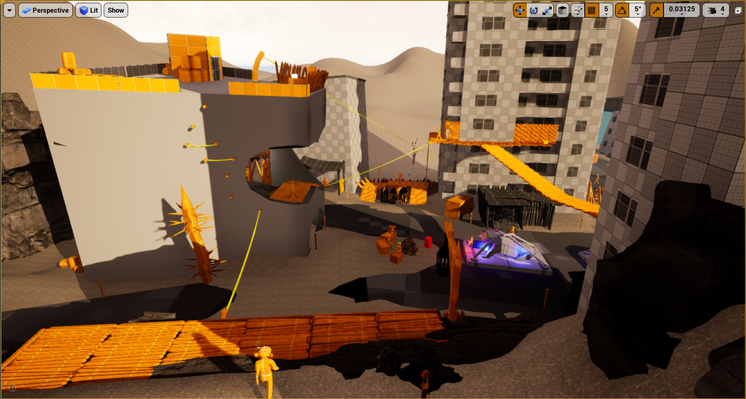
Framing
The level is designed in a way the player will never be able to see the 100% of the game space to force him to move through the space and find the rest of the elements and enemies, engaging exploration.

Slide 10
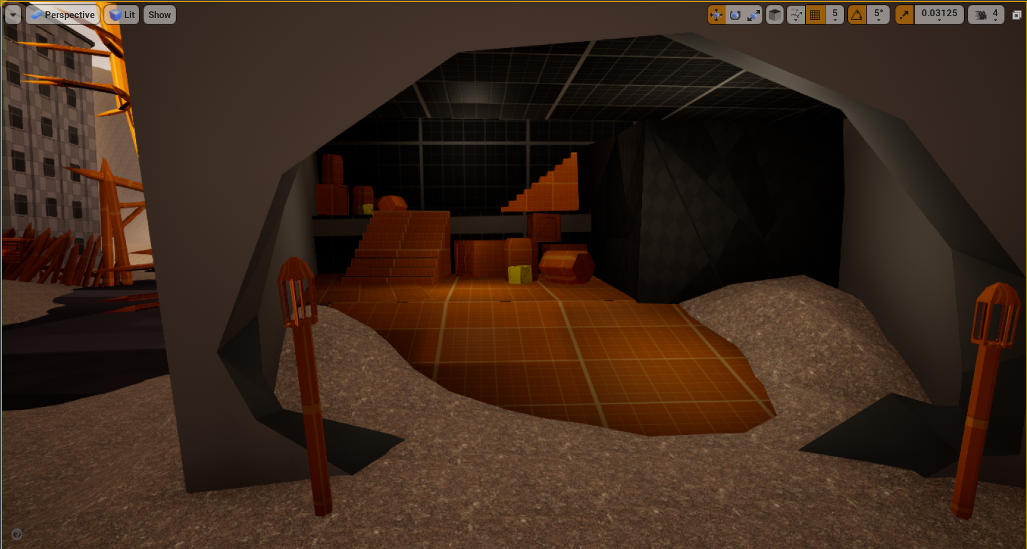
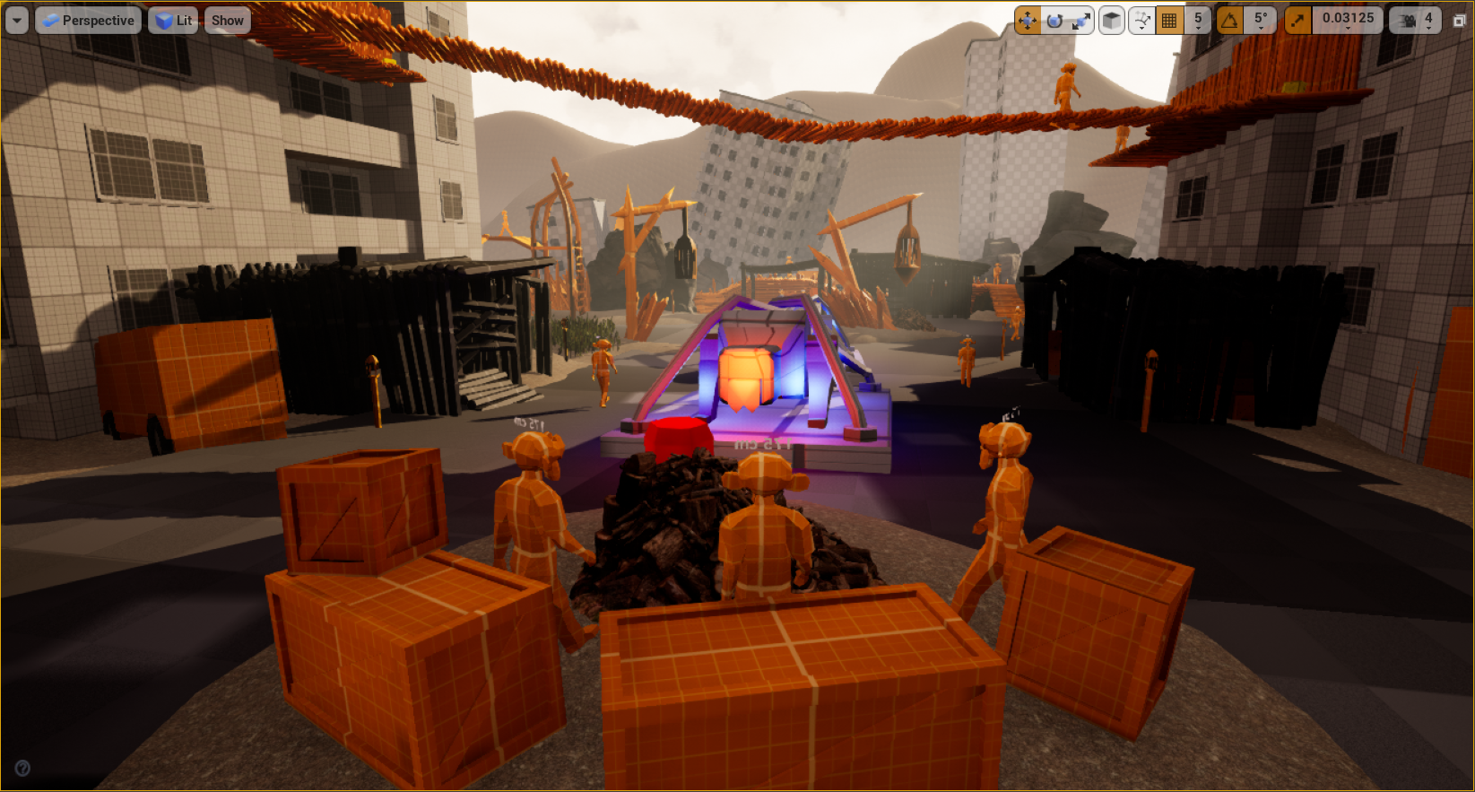
Level Placement
The elements of the level are placed in a way to create occlusion between them to force the player to move in order to shoot properly and also to use those elements as covers, as well as interesting objects for reward to collect.

Slide 11
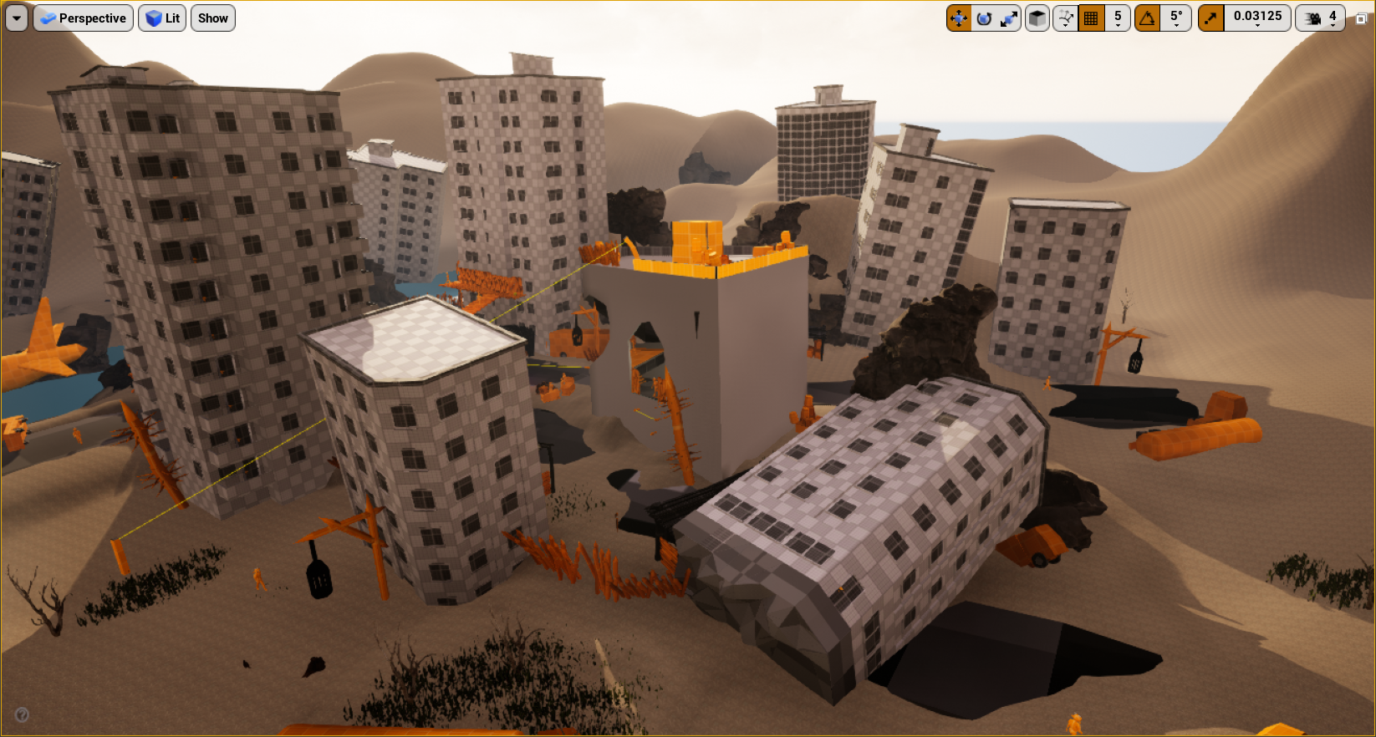
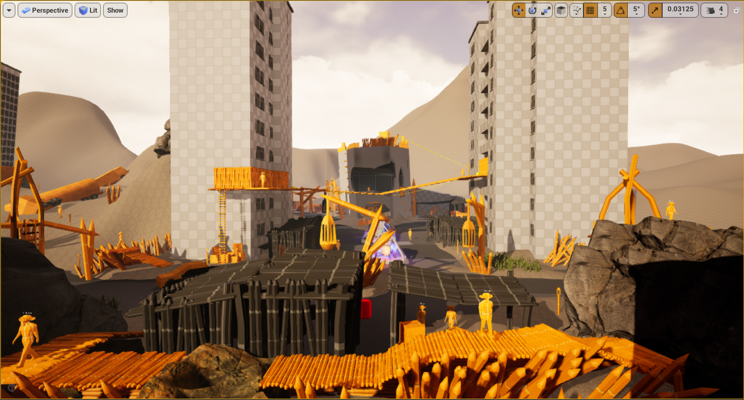
High Landmark
The shape of the triangular building is different from the others in order to use it as a landmark to help the player orientate around the bandit camp, so he never get lost and can create a mental map of where he is and where are all the elements of the game space.

Slide 12
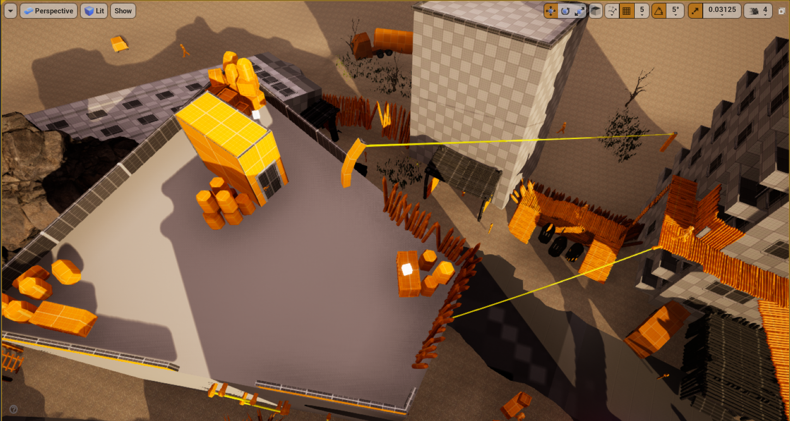
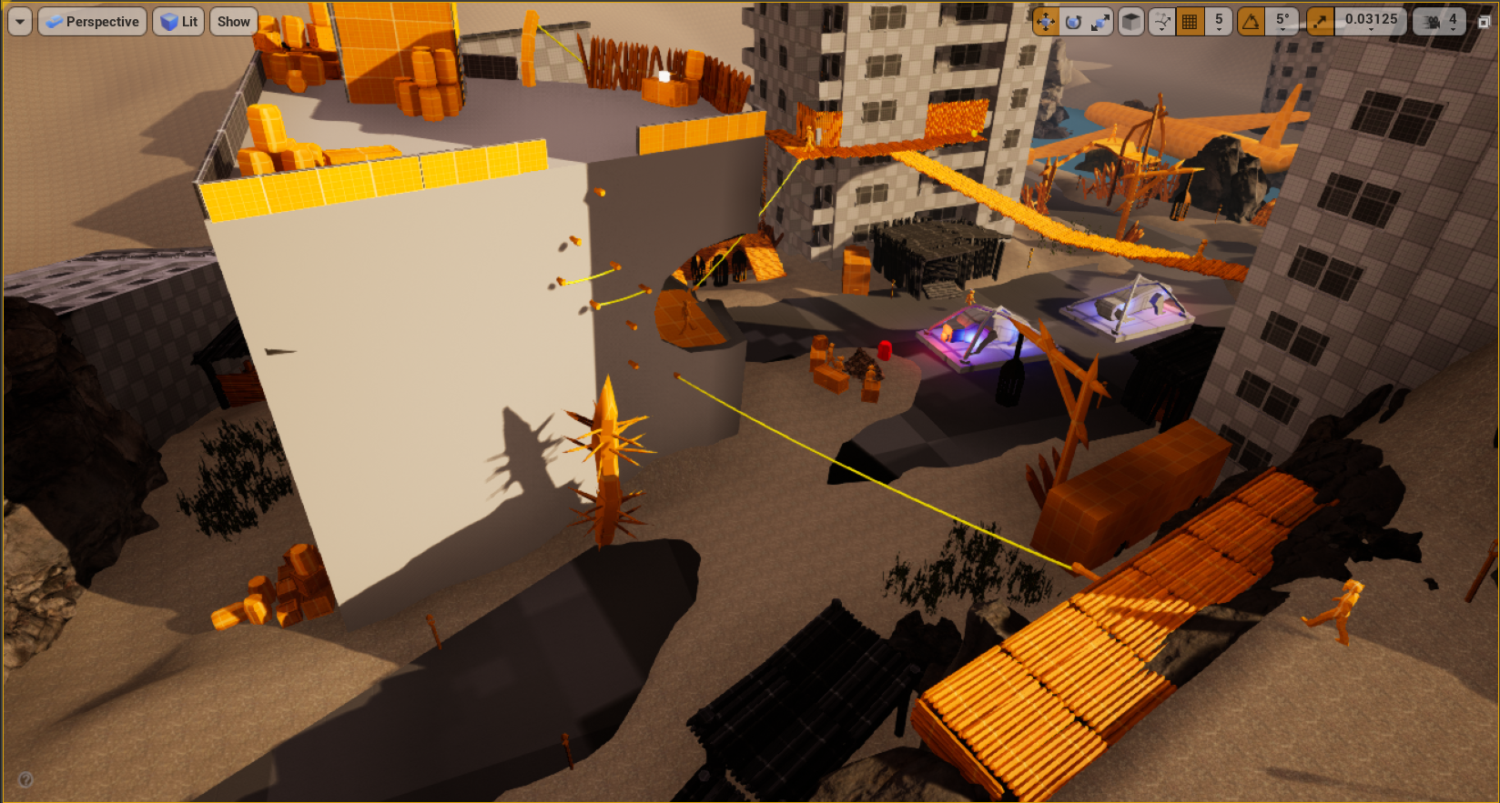
Loop
The entire level is designed in a “loop” concept in which they will never need to do “backtracking”, they will always move forward, to avoid dead ends and give the player the feeling he is always progressing forward.

Slide 13
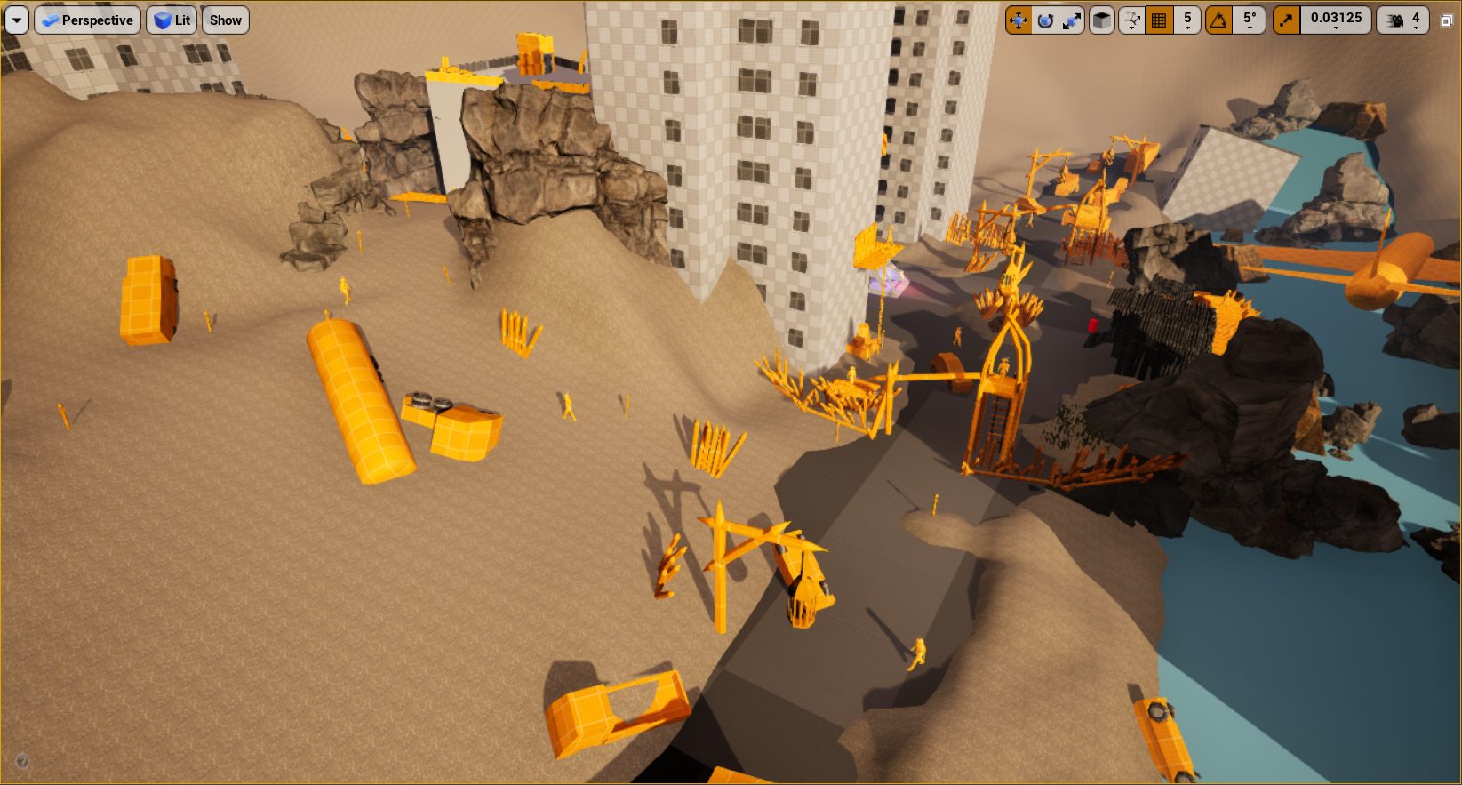
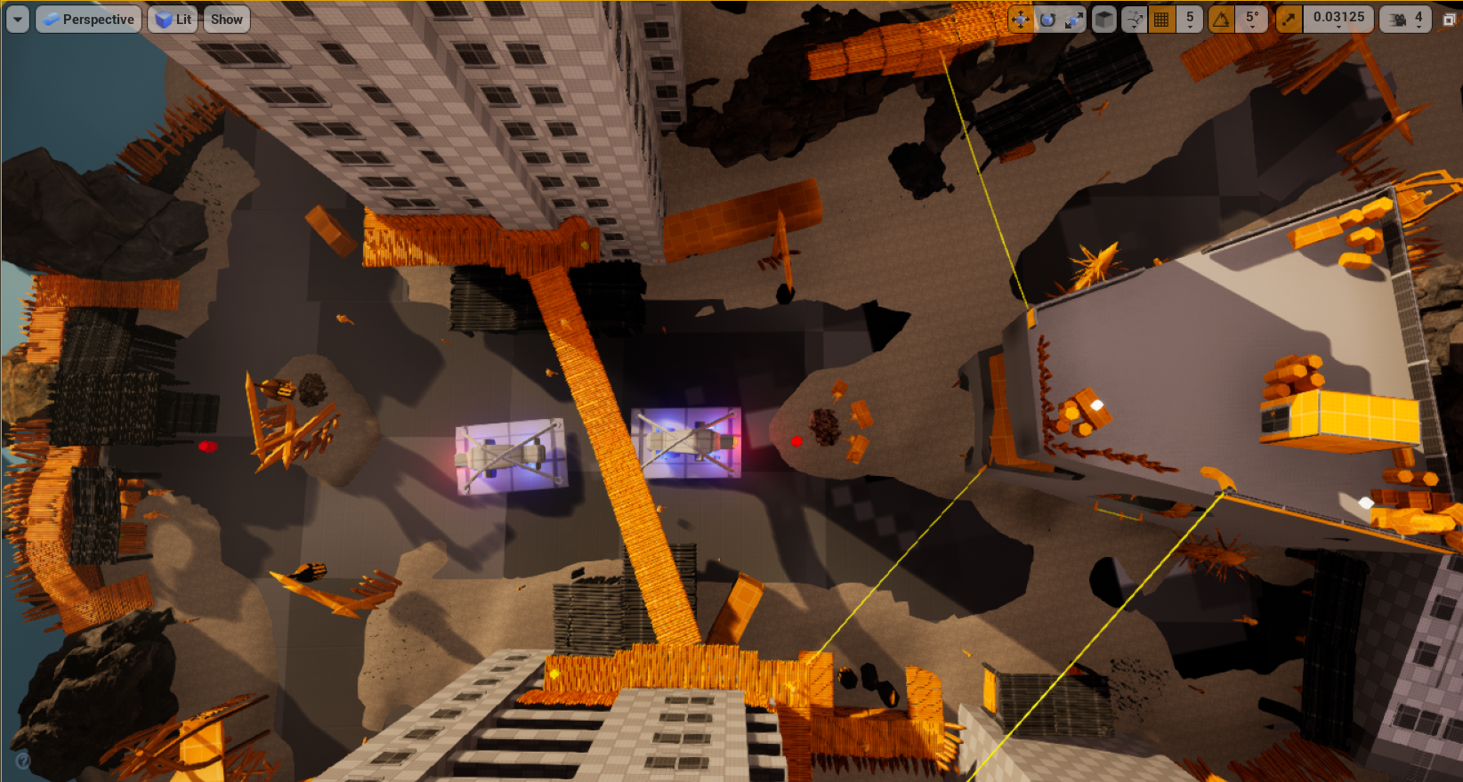
Shape Theory
The level shape its's been carefully build in a way to create interesting shapes and game spaces from the negative and positive space in order to “push and pull” the player to move around engaging a nice navigation through the level.

Slide 14


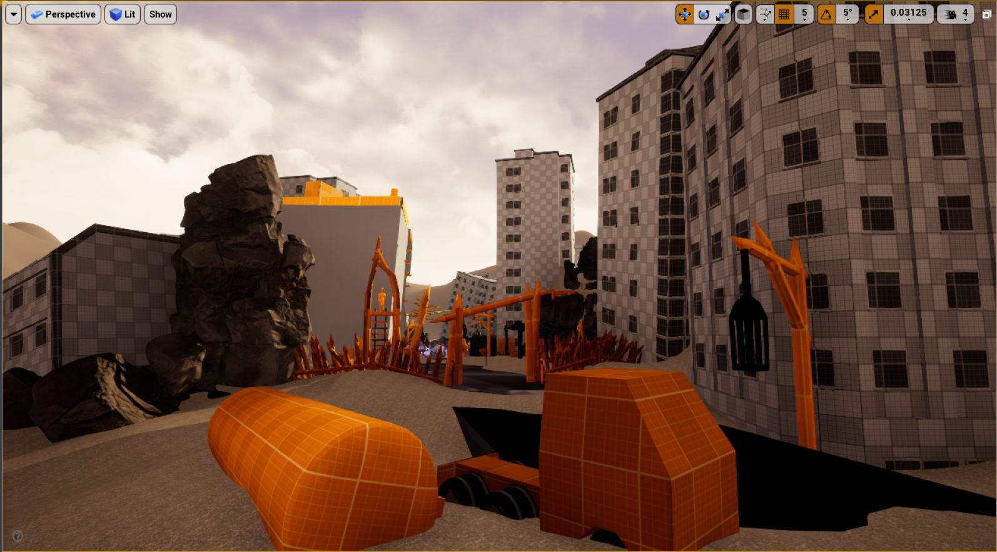
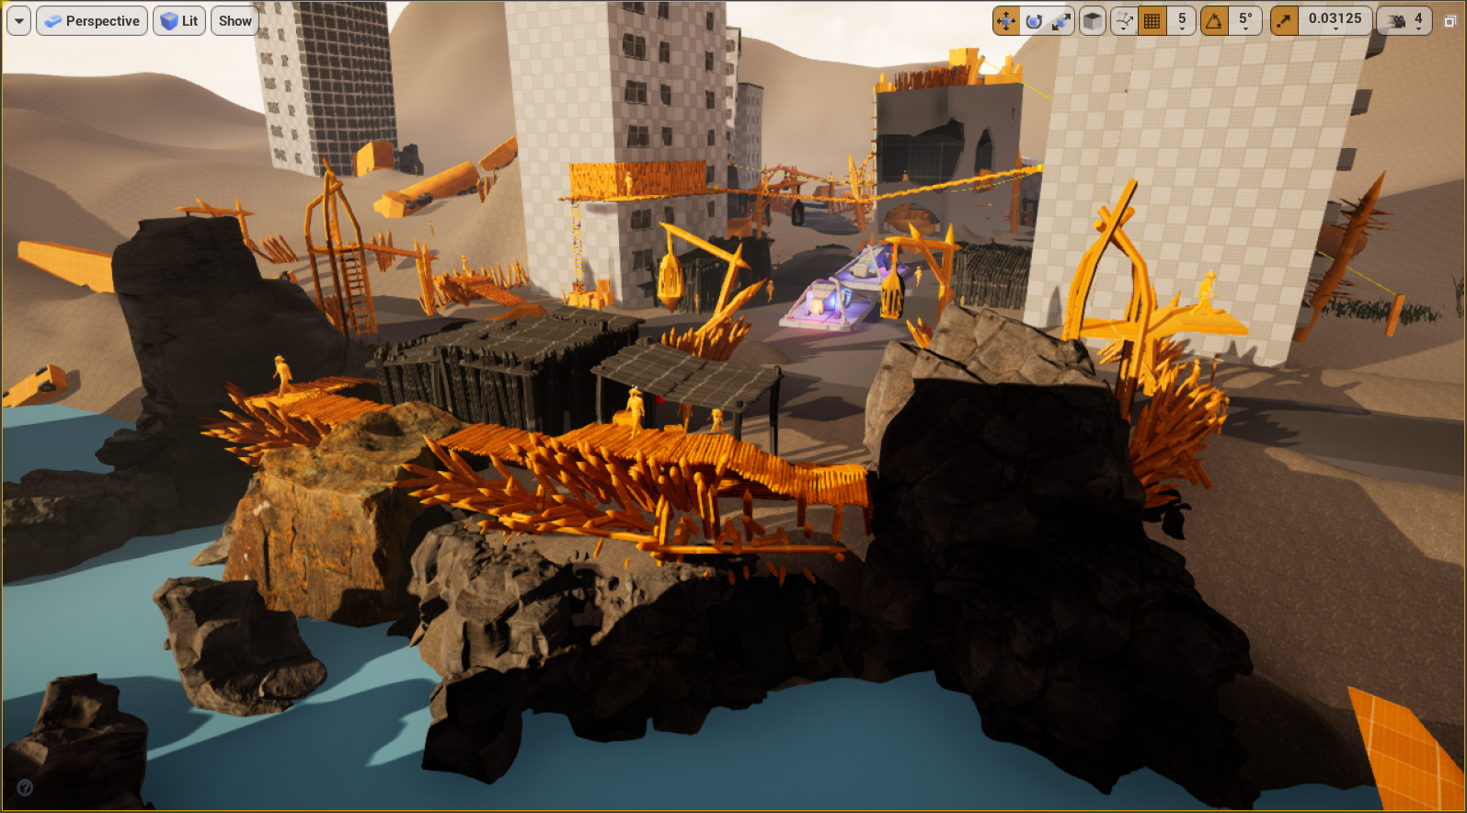
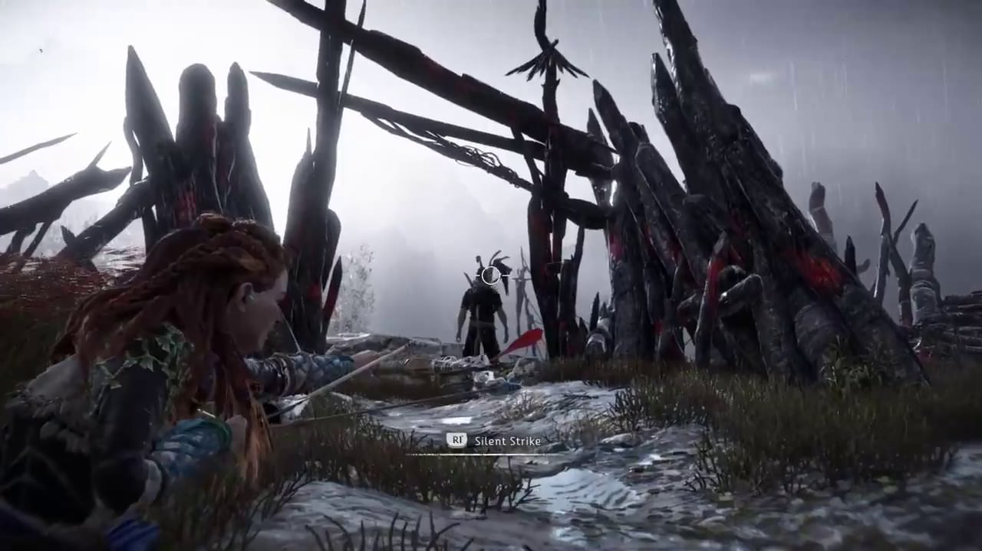
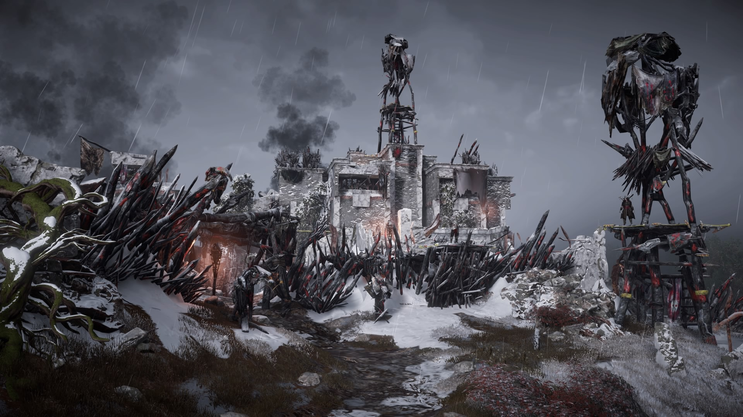
Blockout
Tools

Slide 15
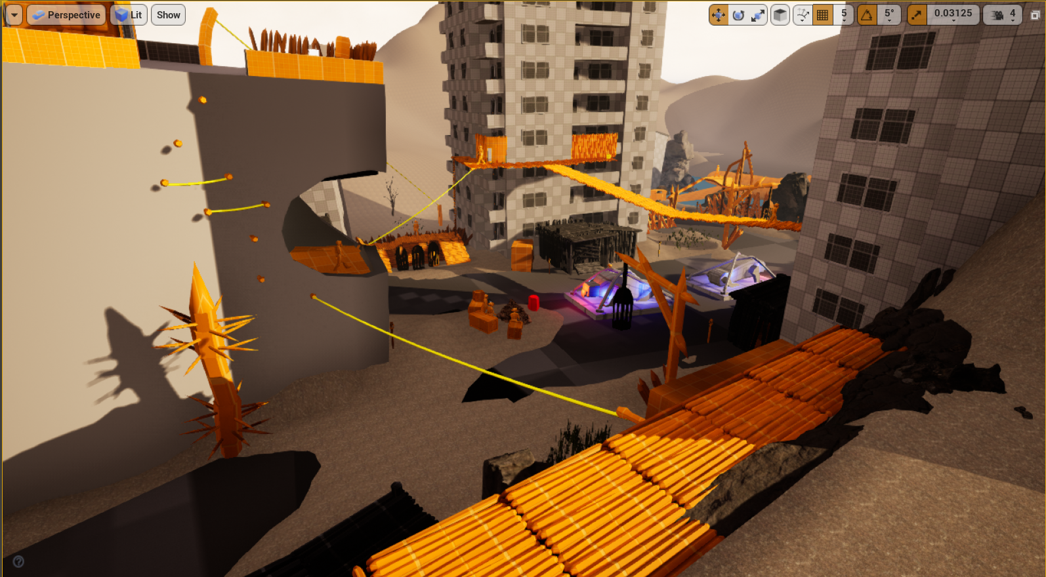
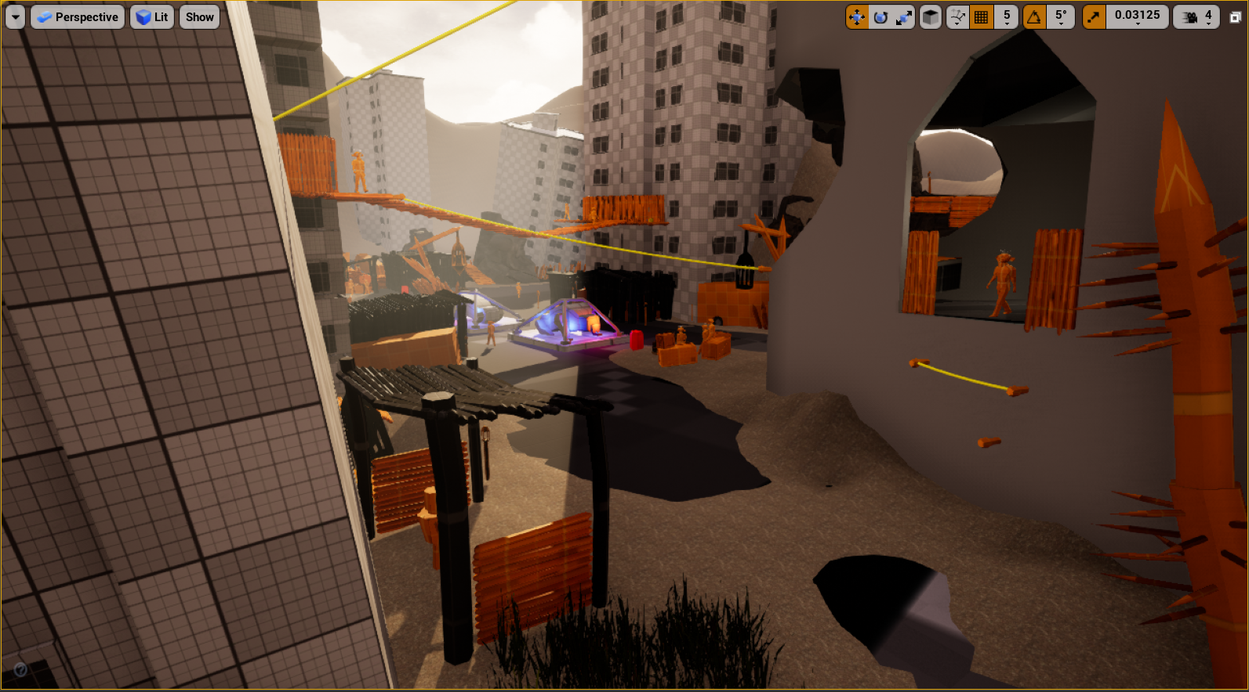
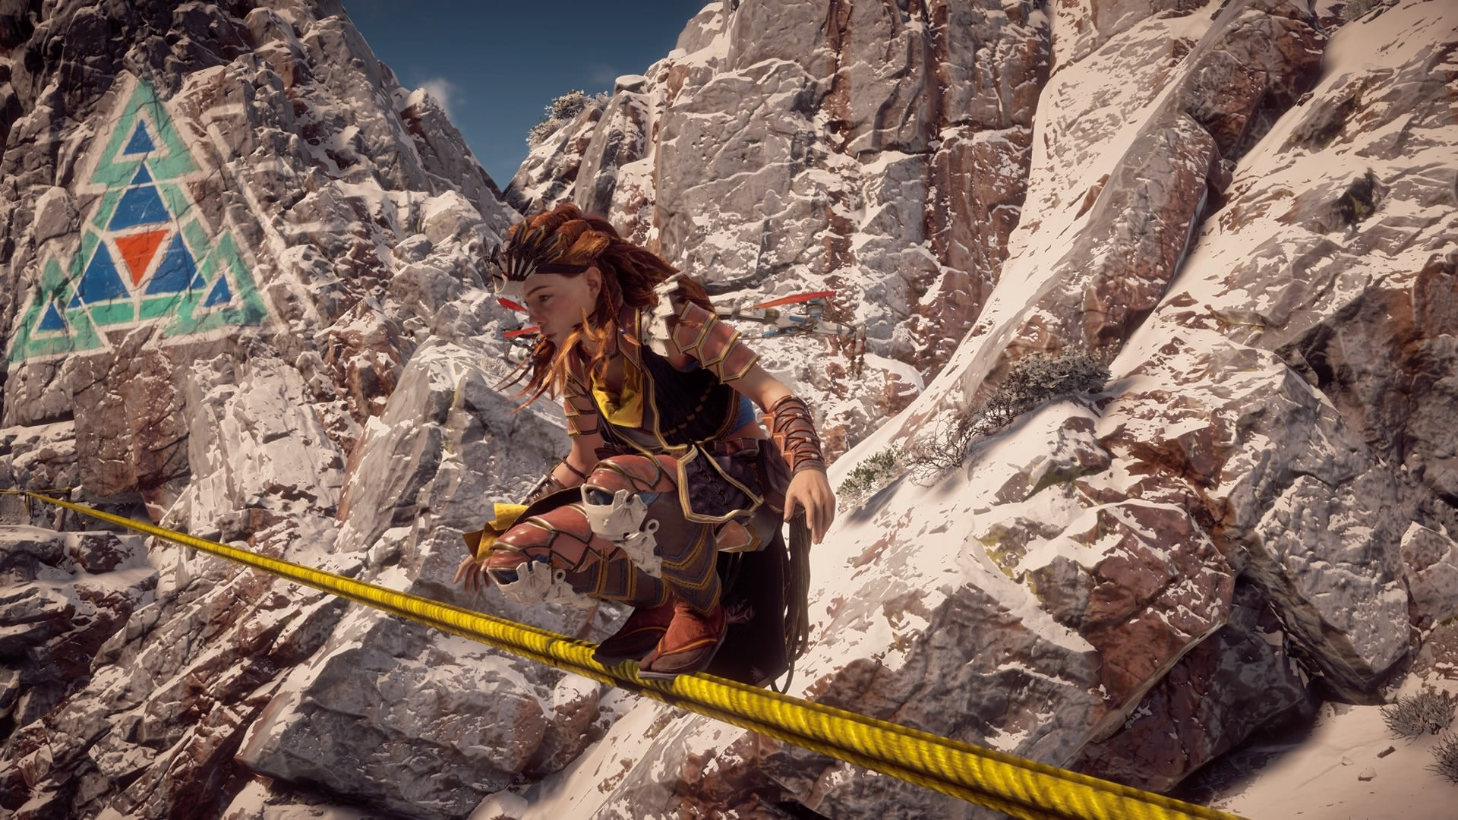
Blockout
Tools

Slide 16
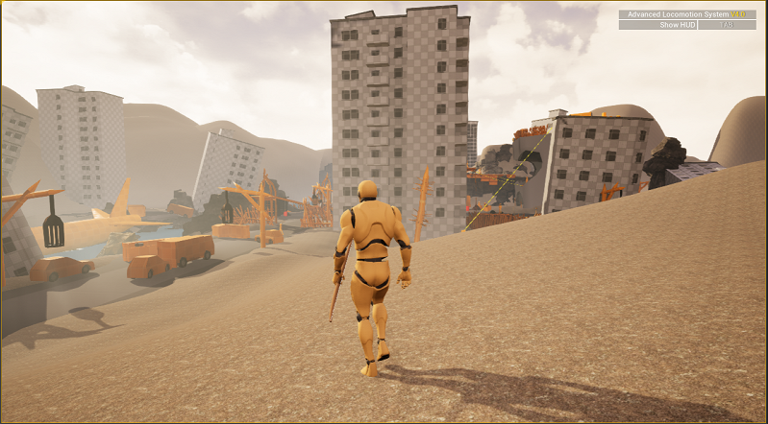
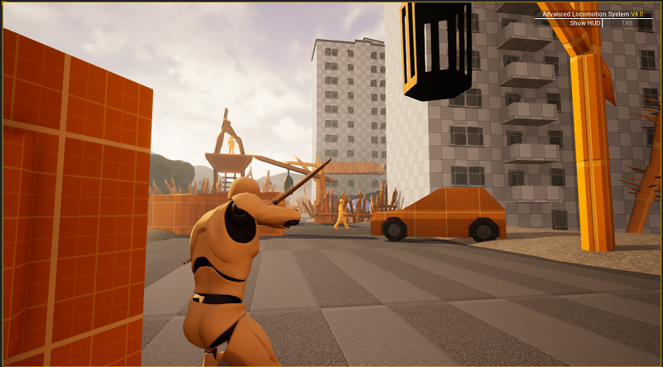
Blockout
Tools

Slide 17
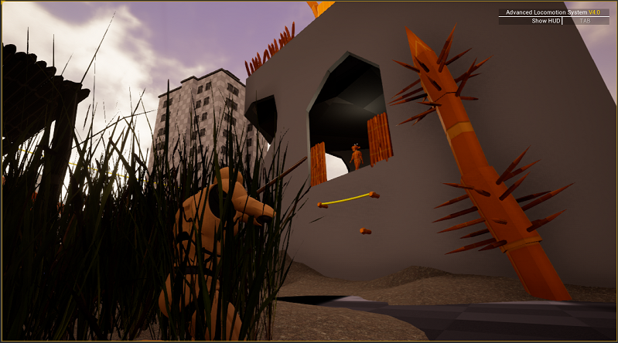
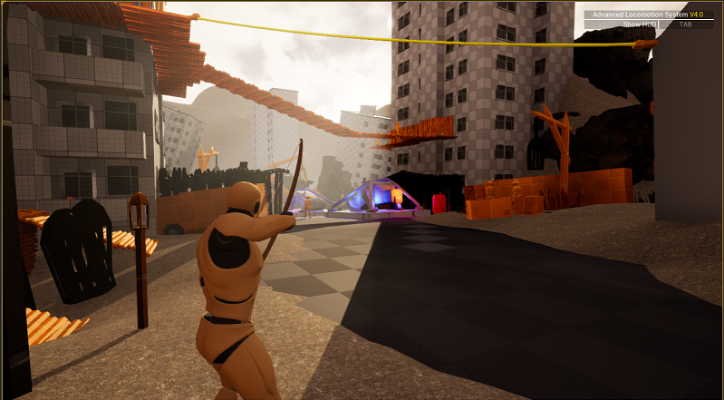
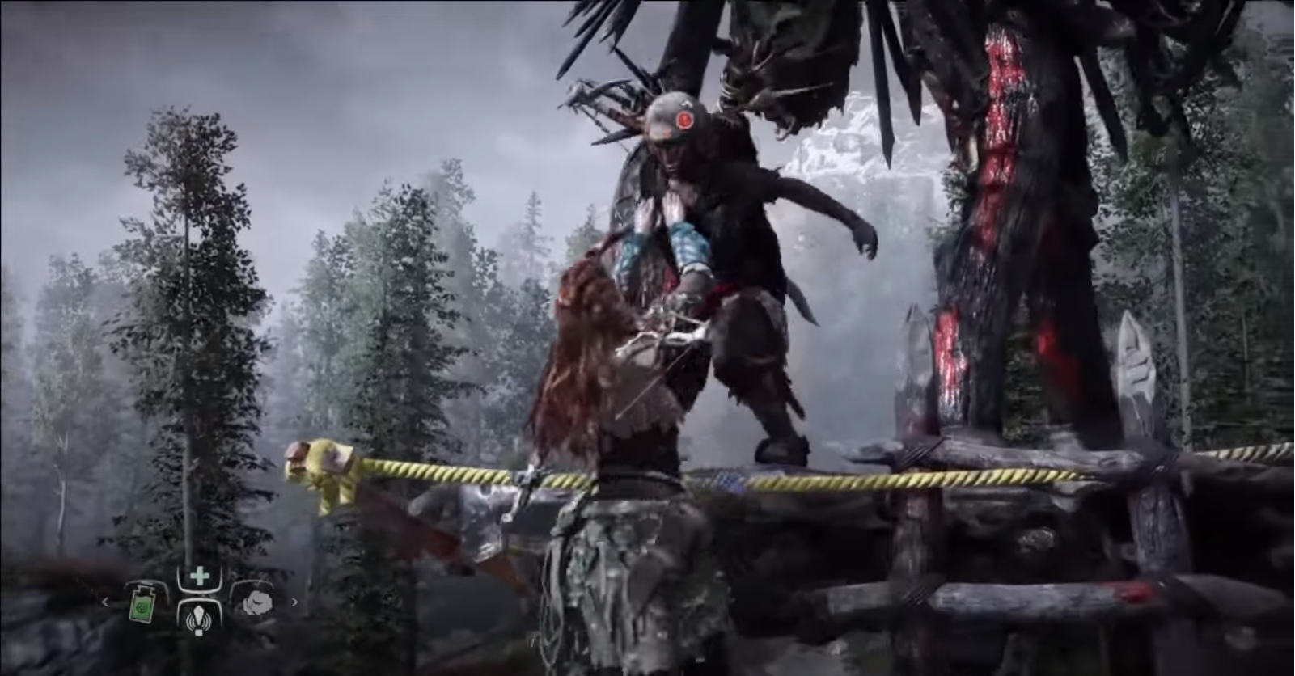
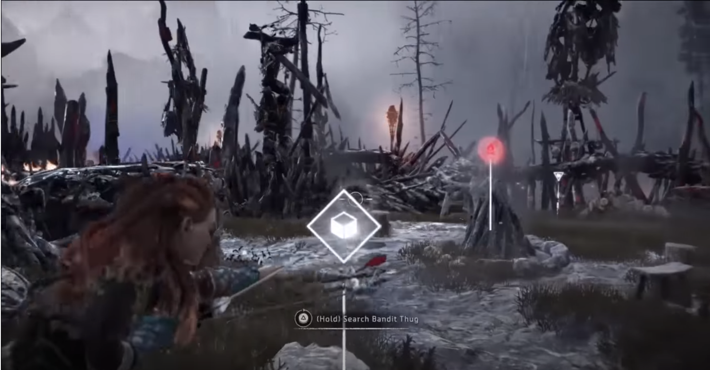
Blockout
Tools

Slide 18
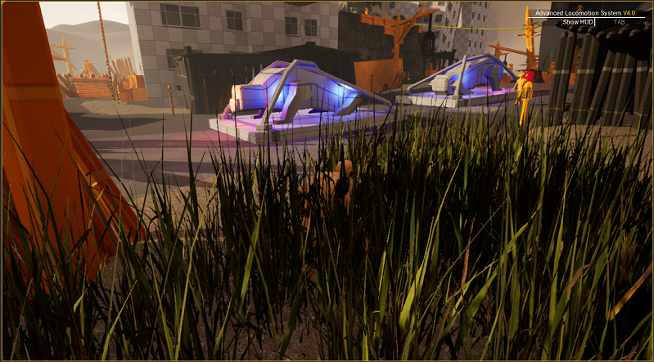
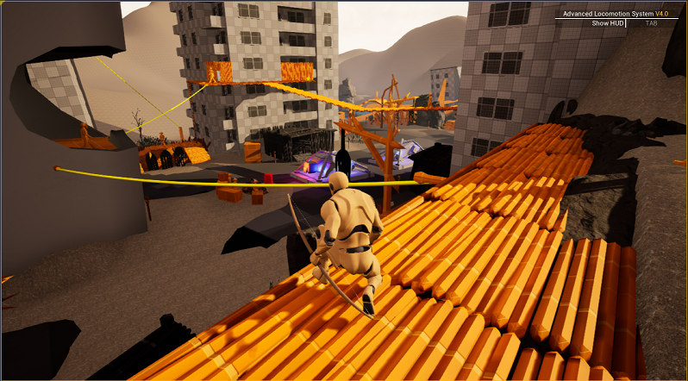
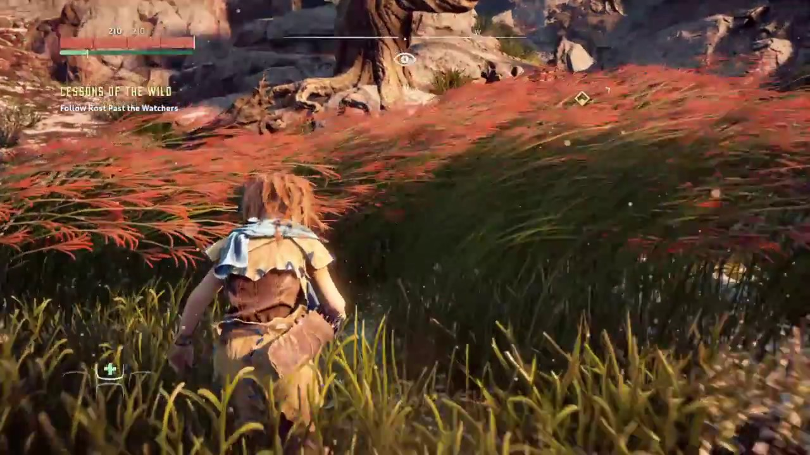
Blockout
Tools

Slide 19
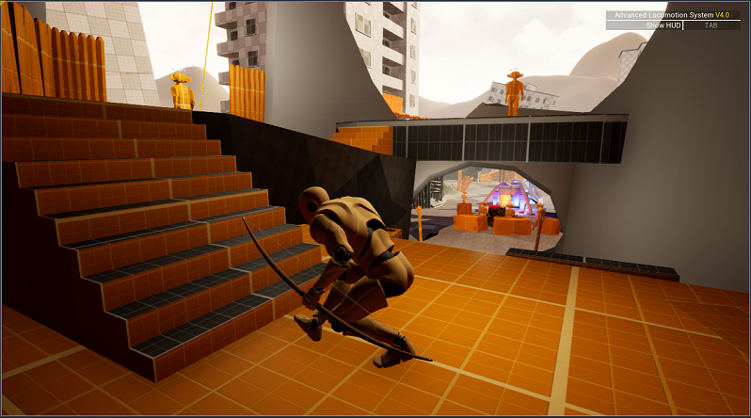
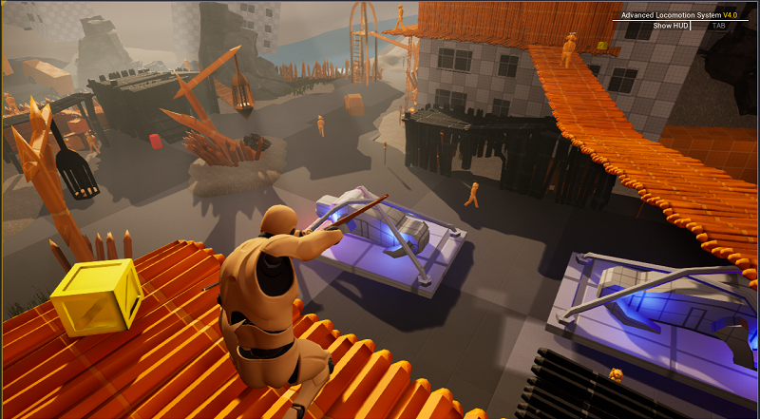
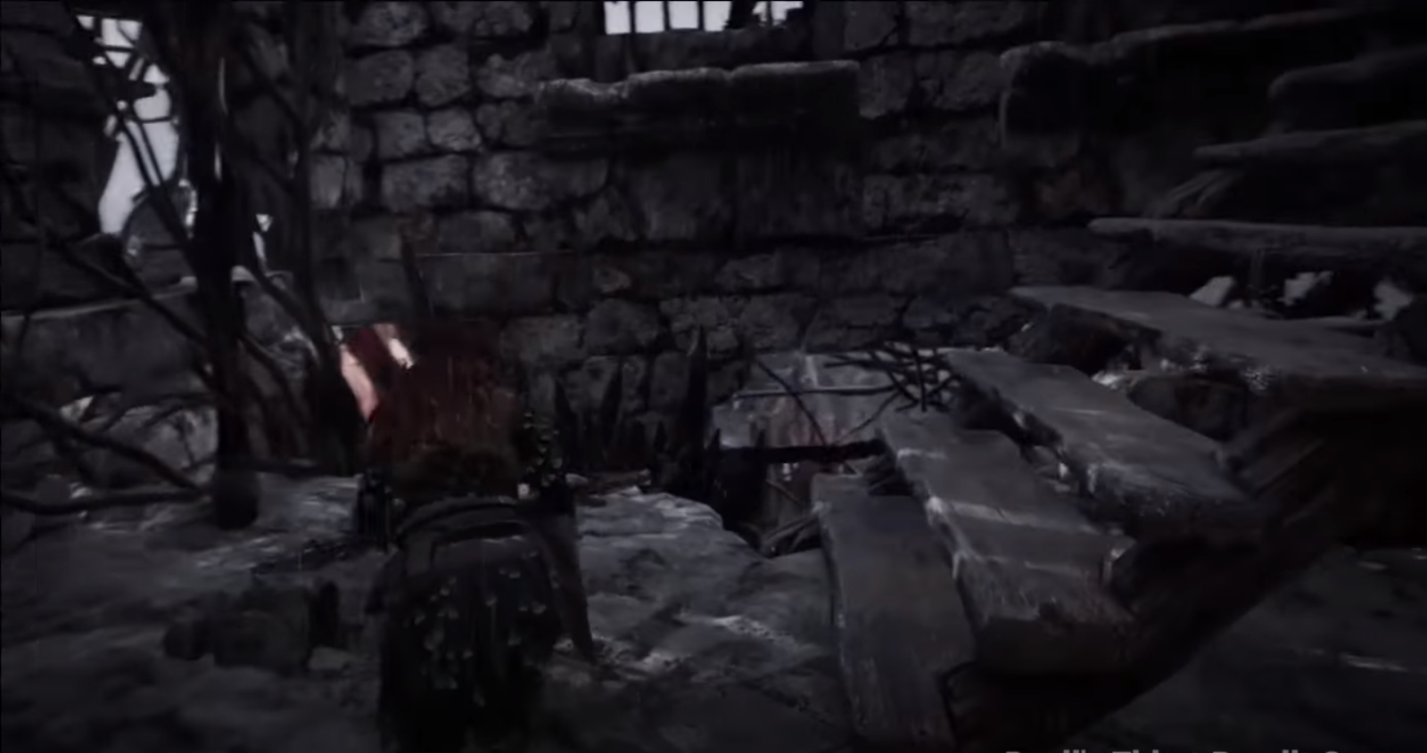
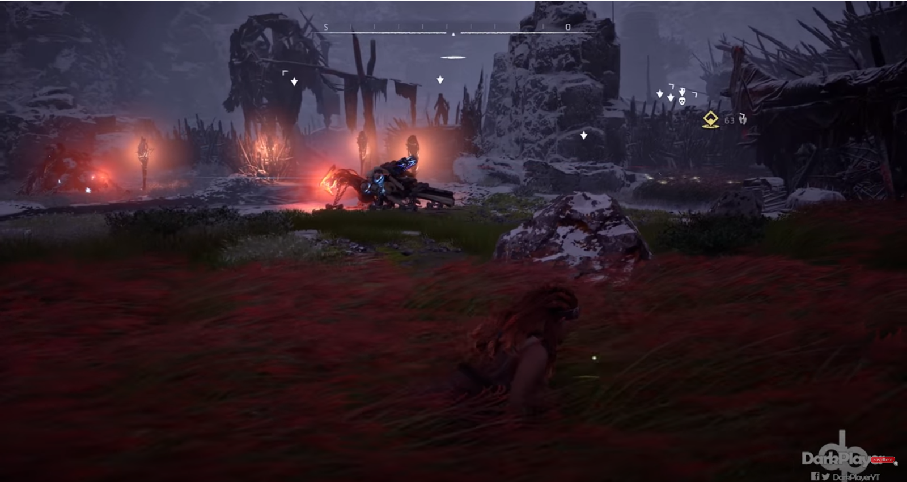
Blockout
Tools

Slide 20
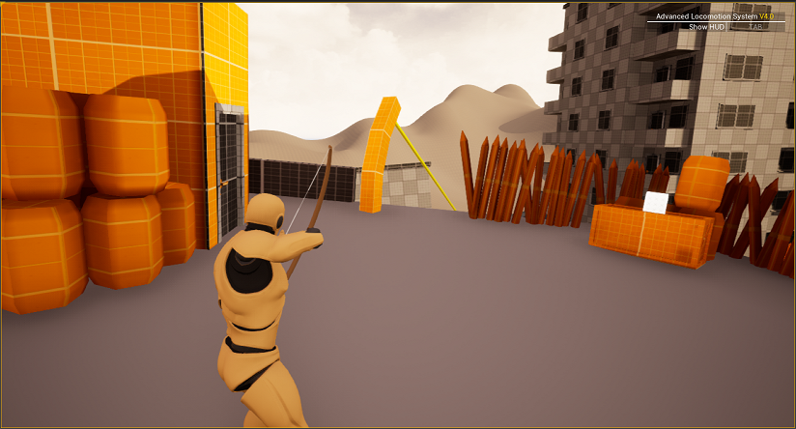
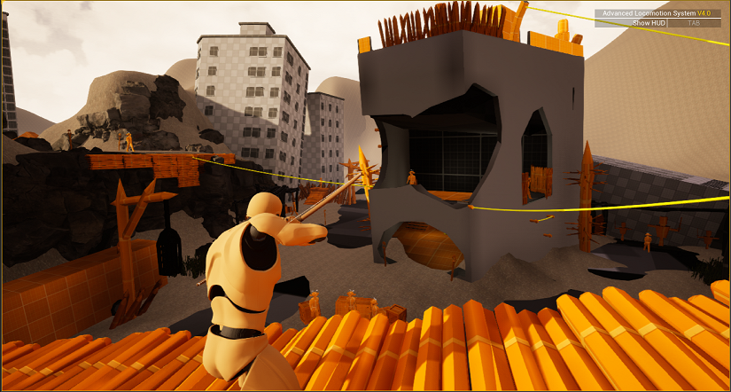
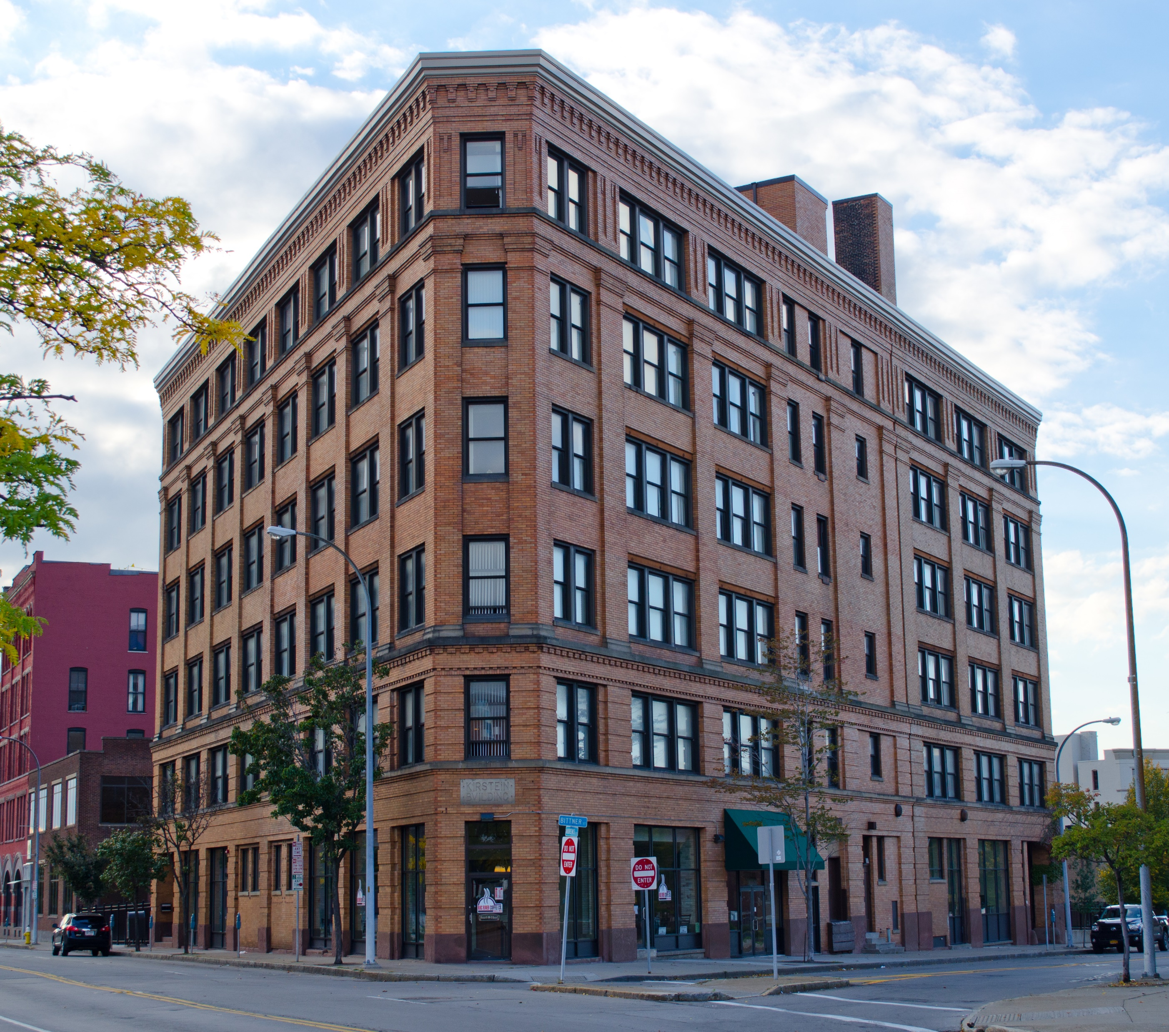
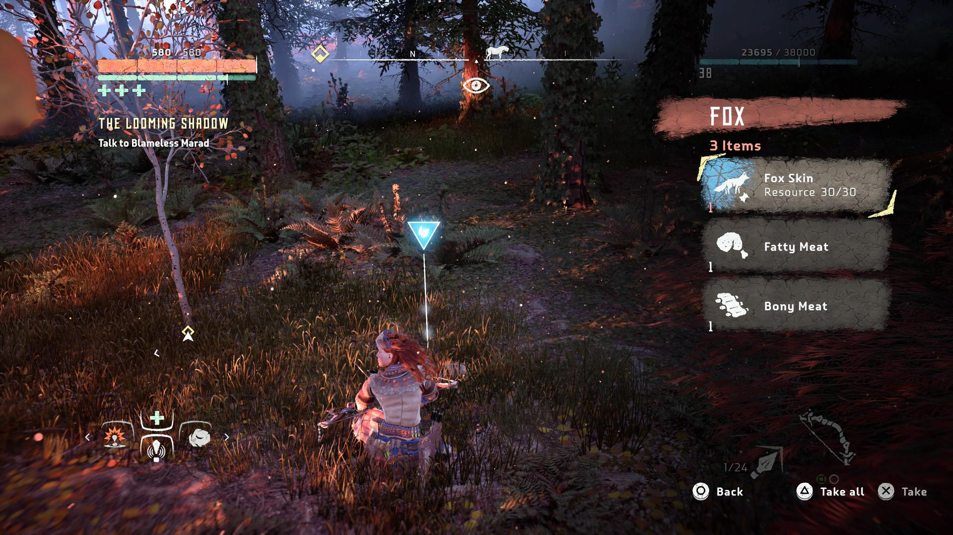
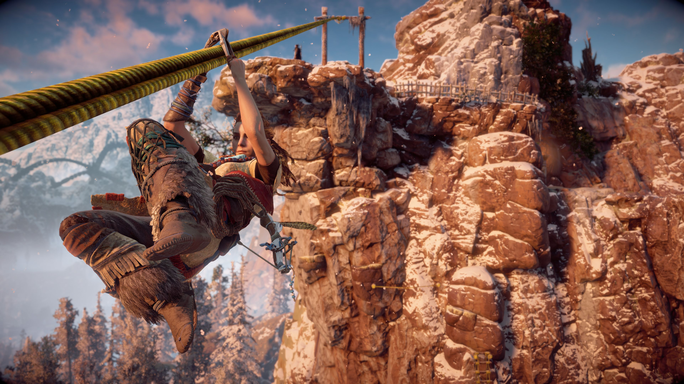
Blockout
Tools

Slide 21
Thank you!

