Slide 1
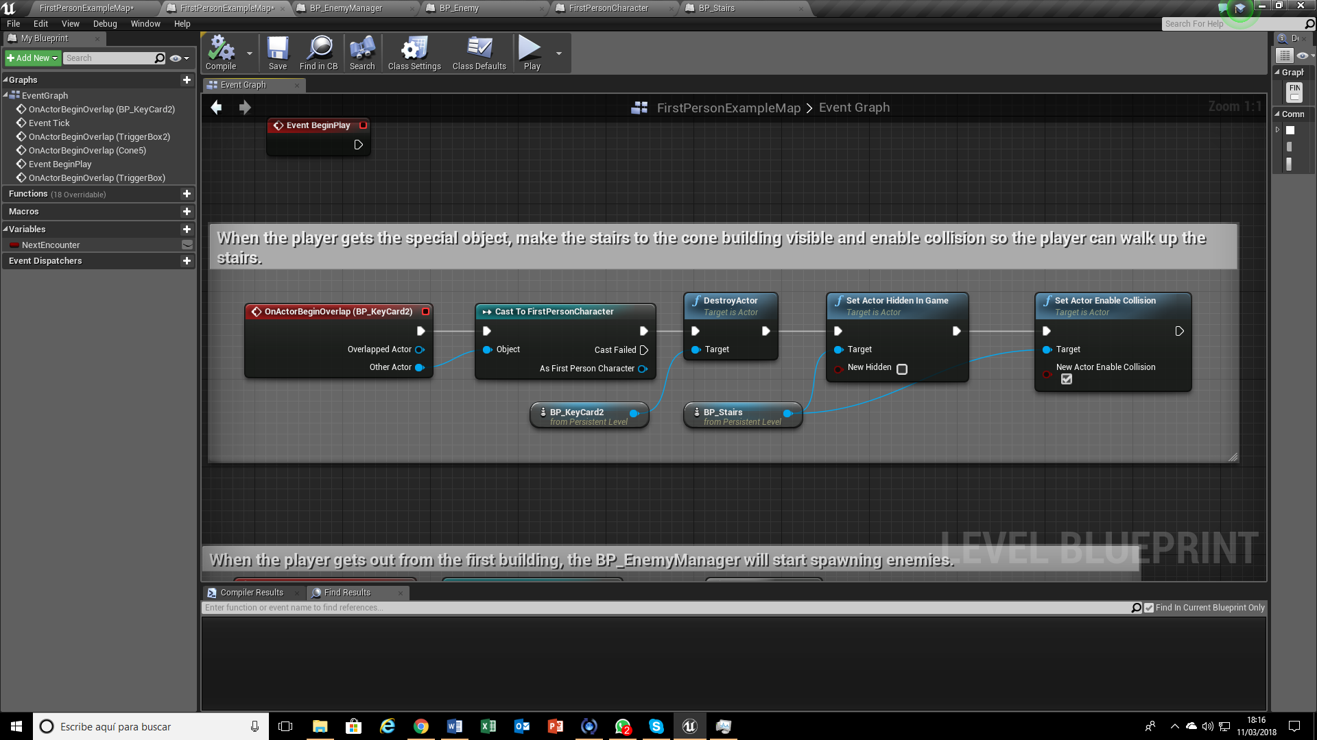
LEVEL BLUEPRINT

Slide 2
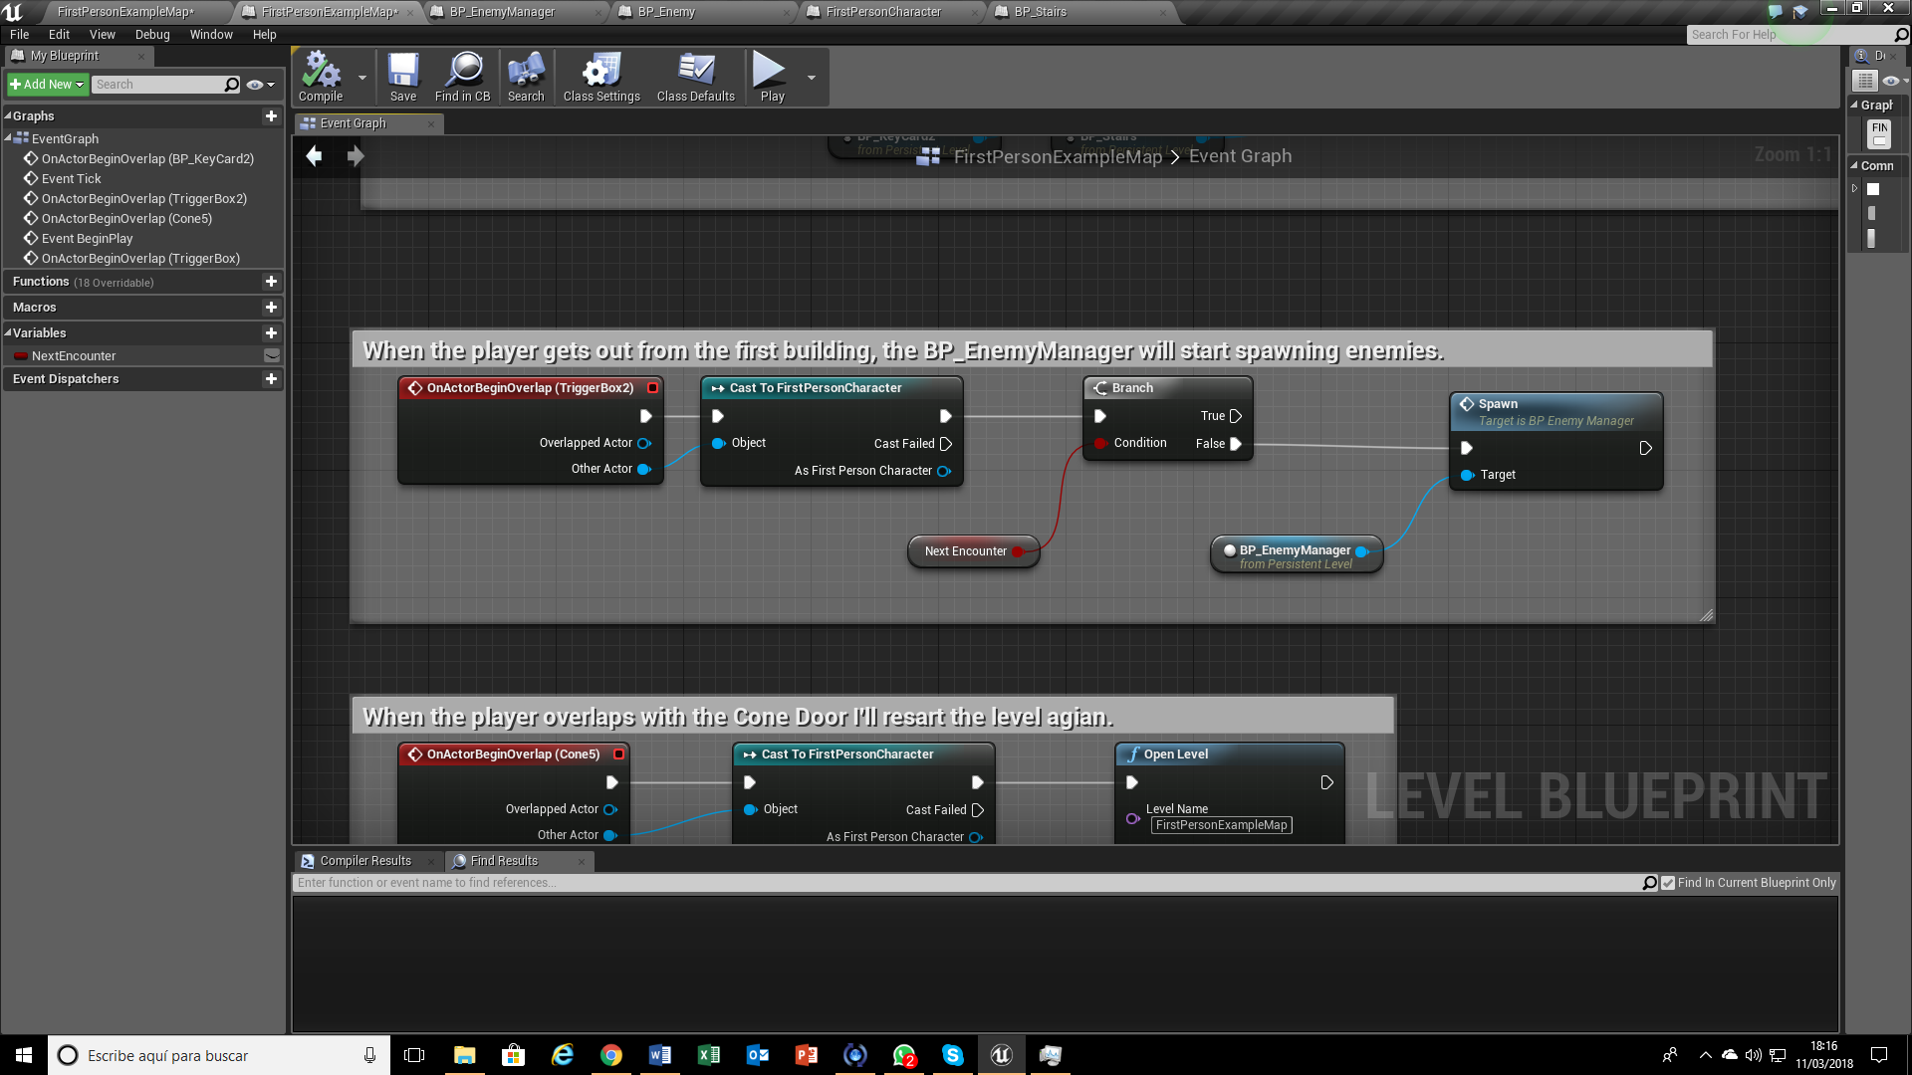
LEVEL BLUEPRINT

Slide 3
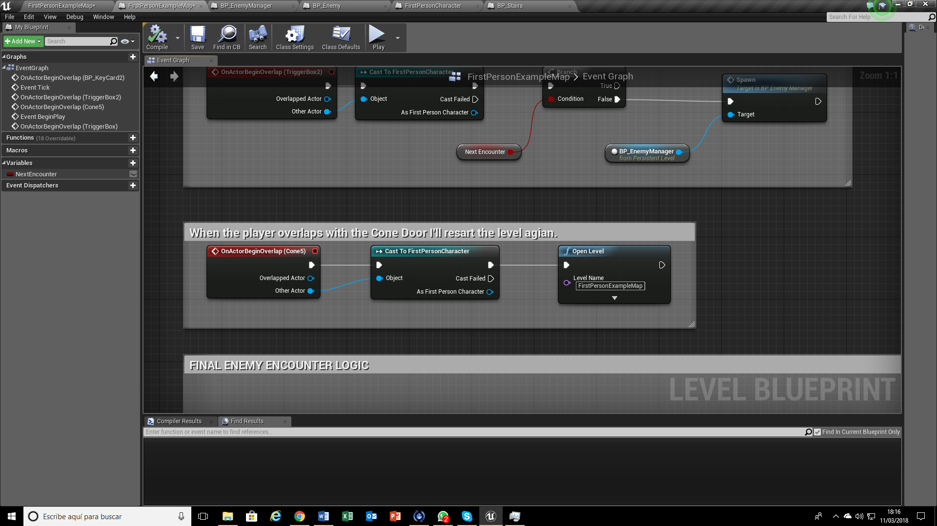
LEVEL BLUEPRINT

Slide 4
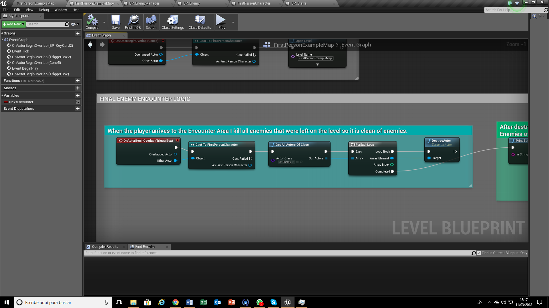
LEVEL BLUEPRINT

Slide 5
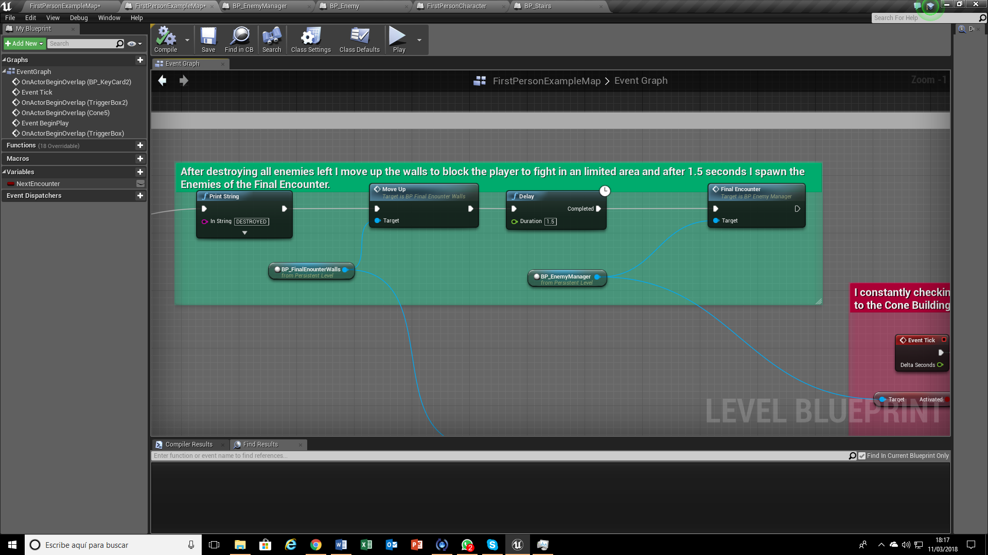
LEVEL BLUEPRINT

Slide 6
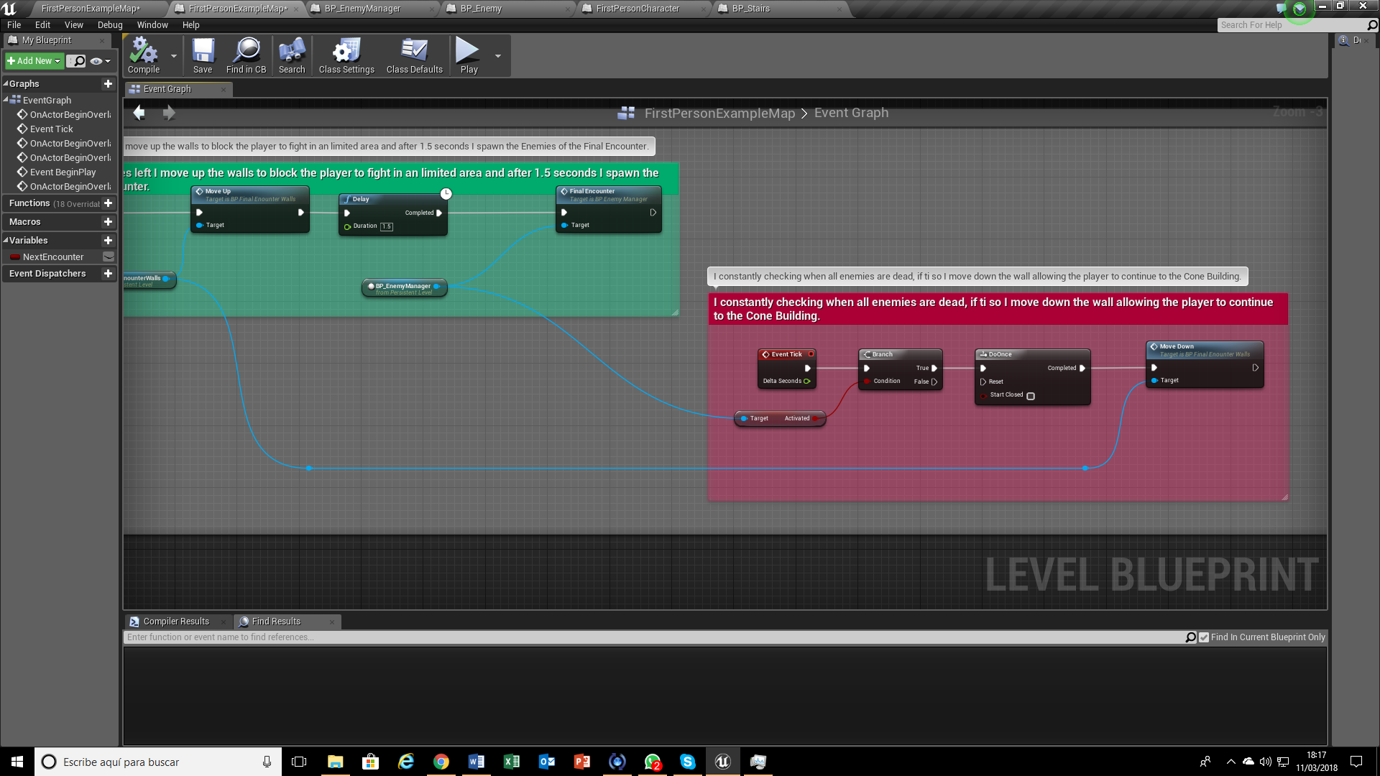
LEVEL BLUEPRINT

Slide 7
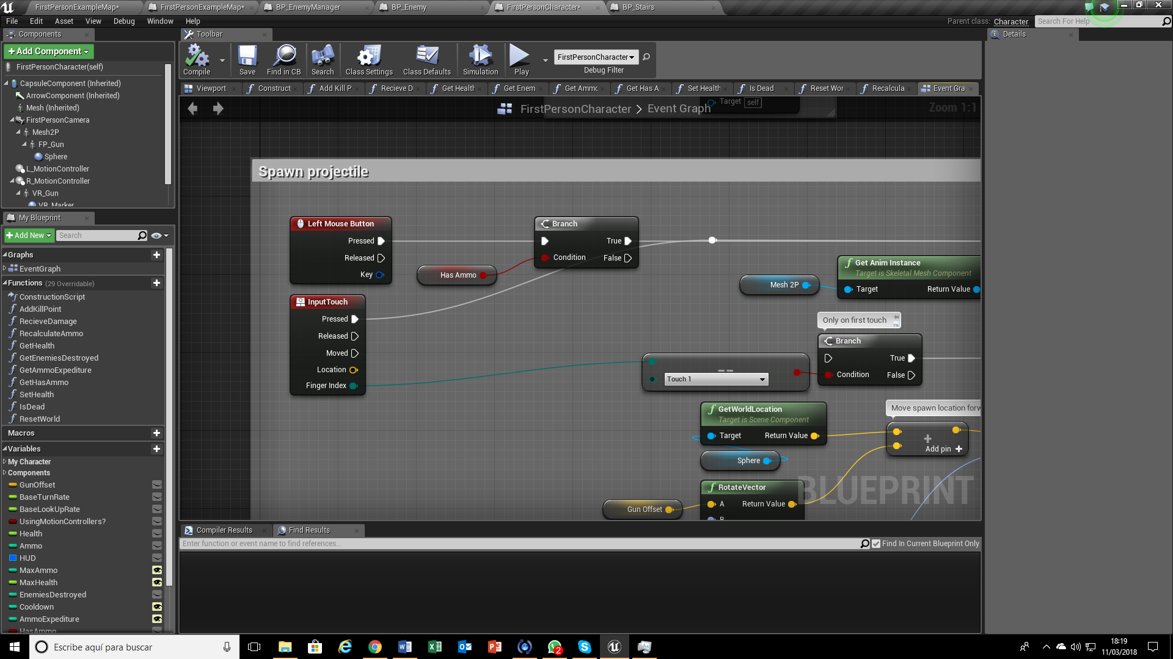
FisrtPersonCharacter modified
On Left Mouse Button I’ve had put a Branch condition to allow the player to shot only if he have ammo.

Slide 8
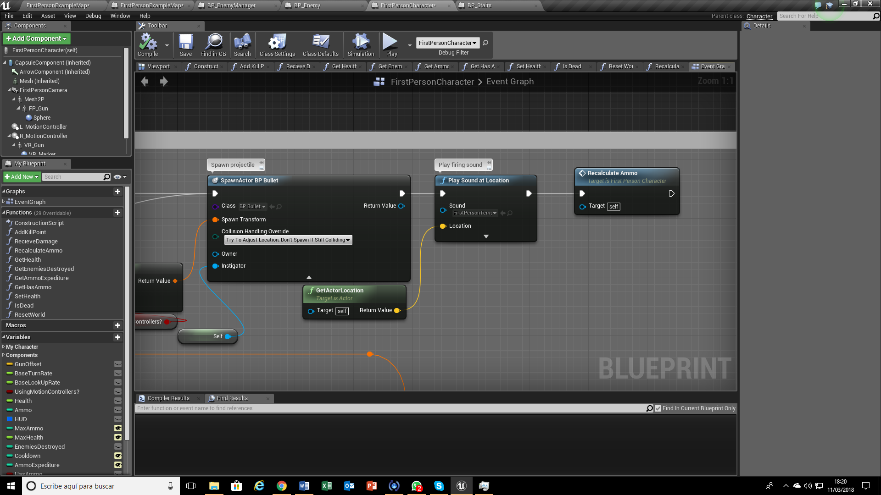
FisrtPersonCharacter modified
Once the player shoots I recalculate the ammo left with a function.

Slide 9
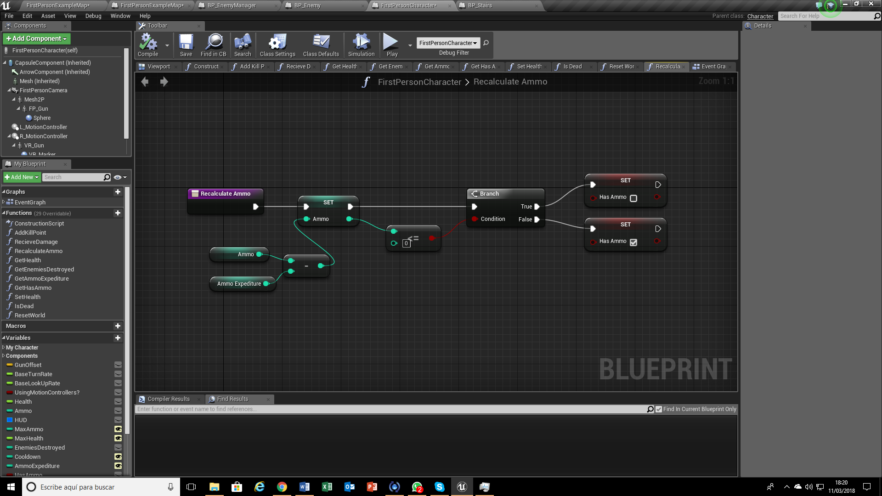
FisrtPersonCharacter modified
Recalculate Ammo Function

Slide 10
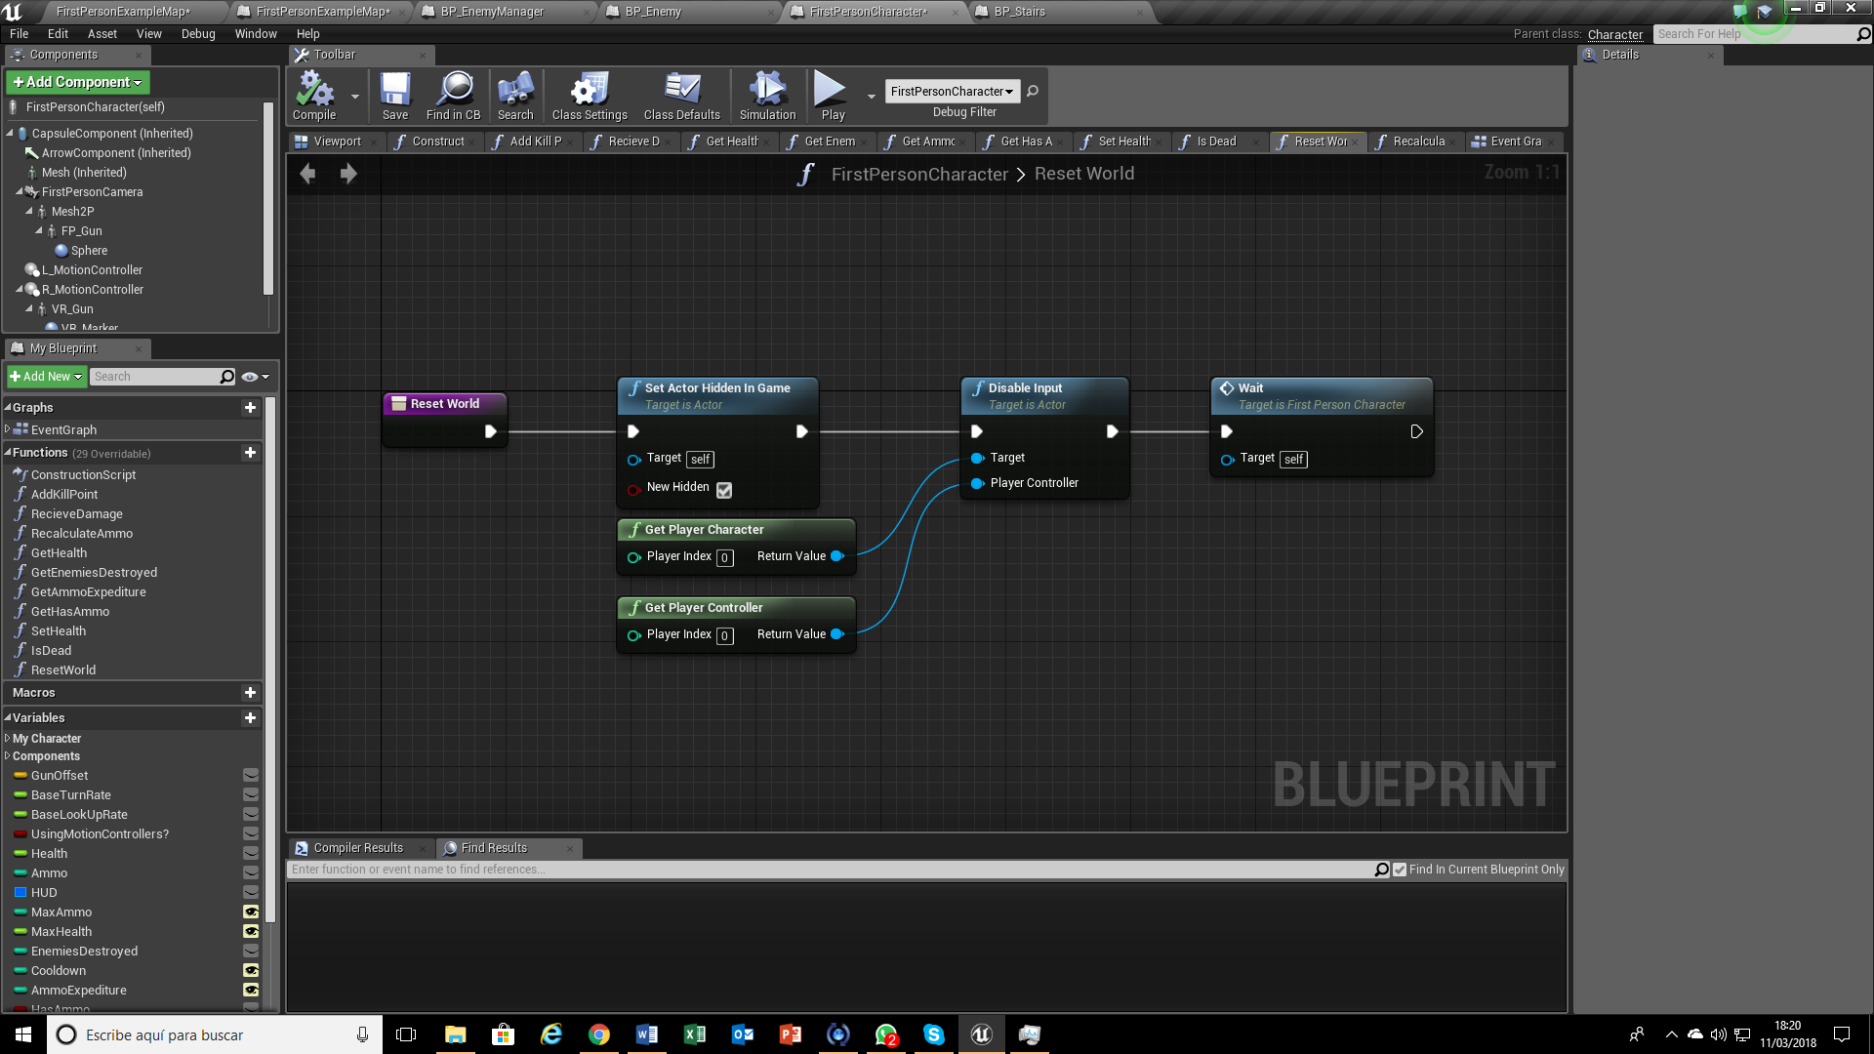
FisrtPersonCharacter modified
Reset World Function

Slide 11
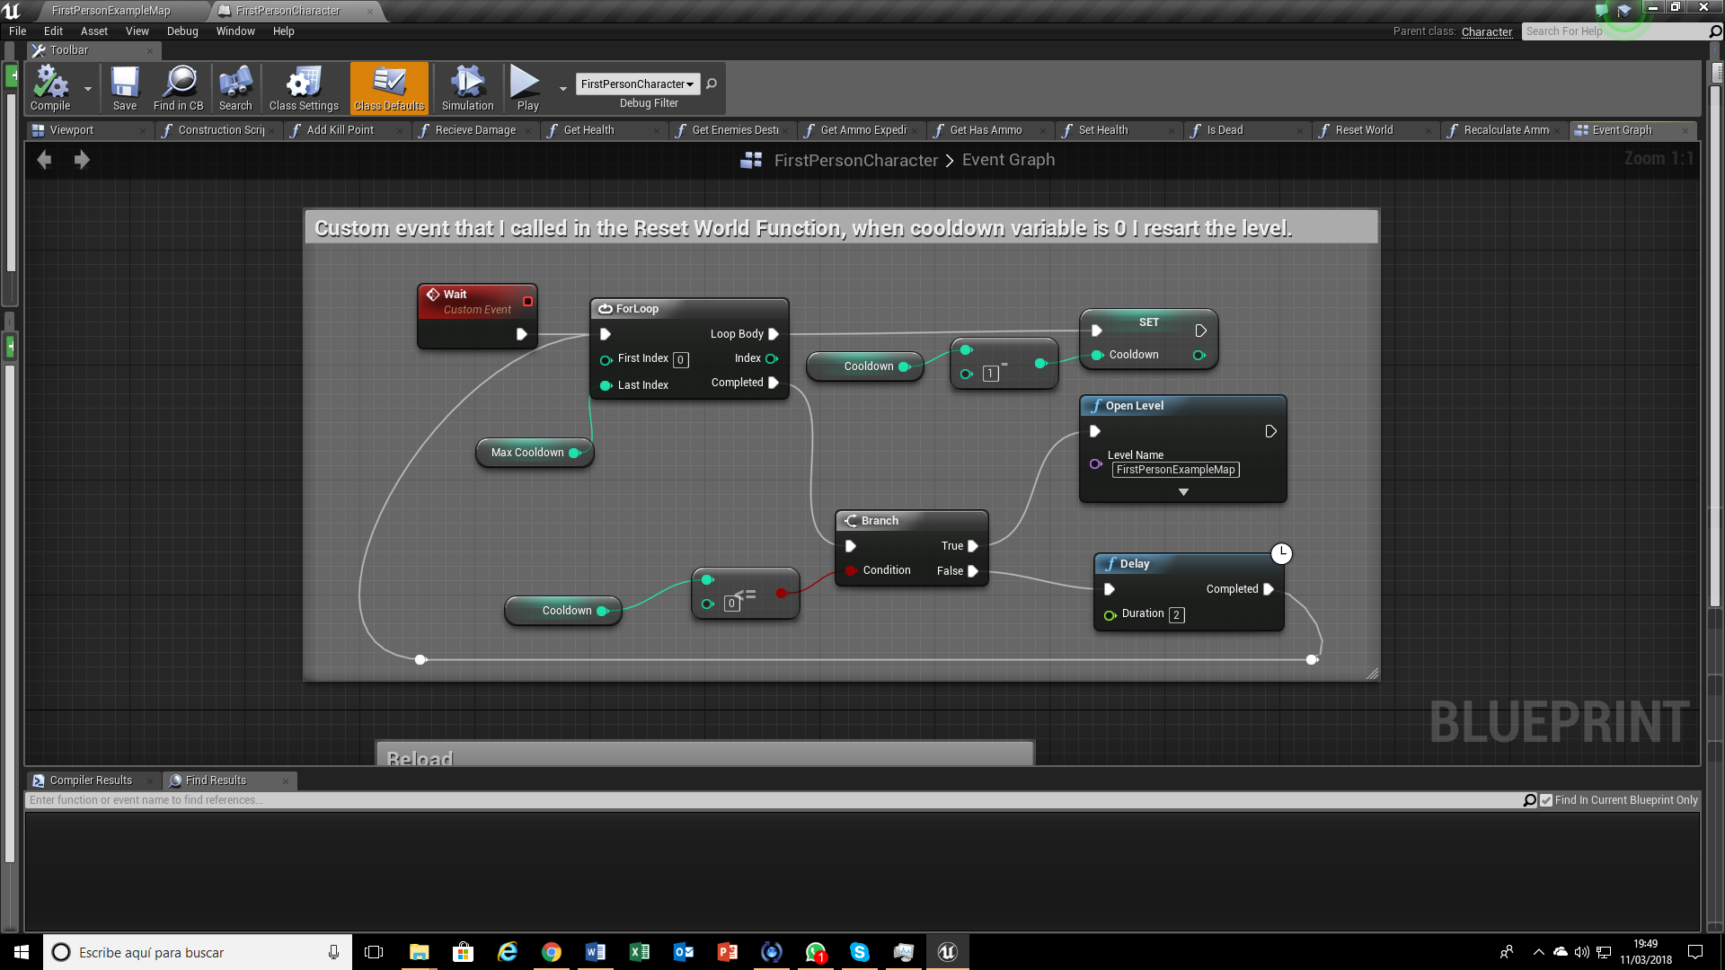
FisrtPersonCharacter modified

Slide 12
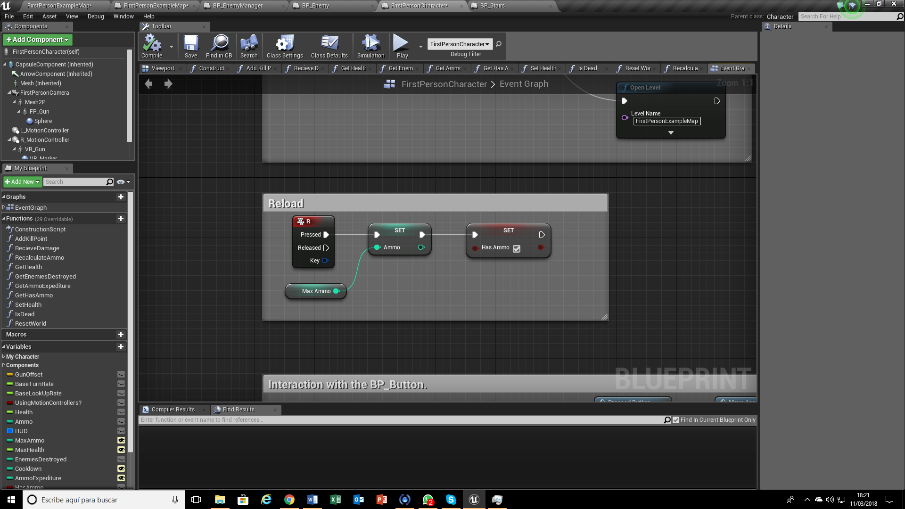
FisrtPersonCharacter modified

Slide 13
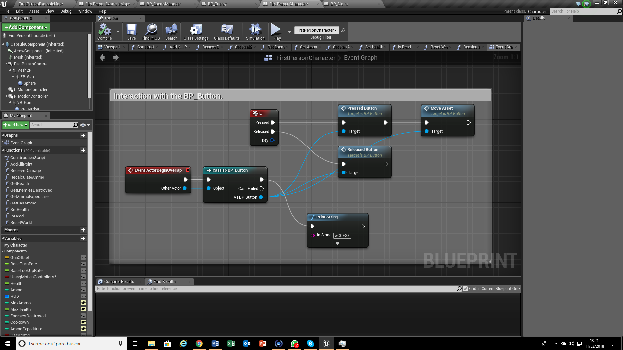
FisrtPersonCharacter modified

Slide 14
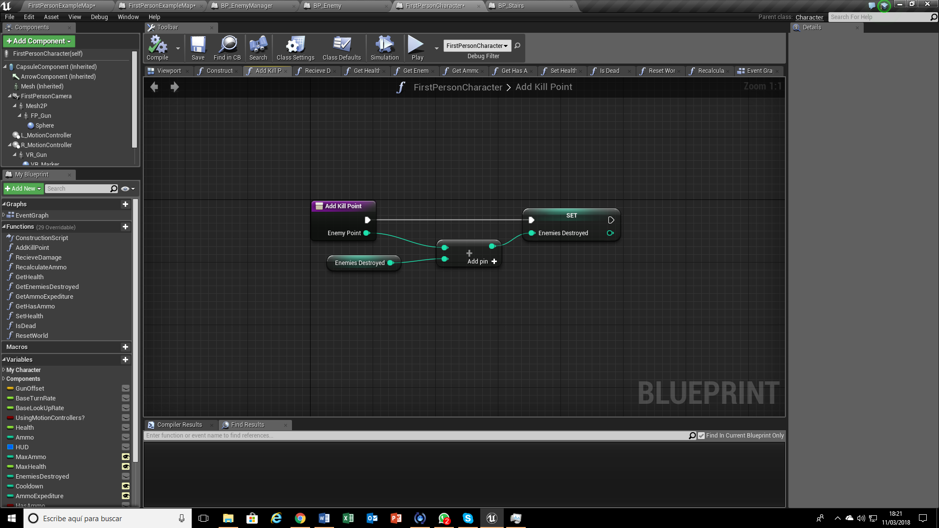
FisrtPersonCharacter modified
Add Kill Point Function

Slide 15
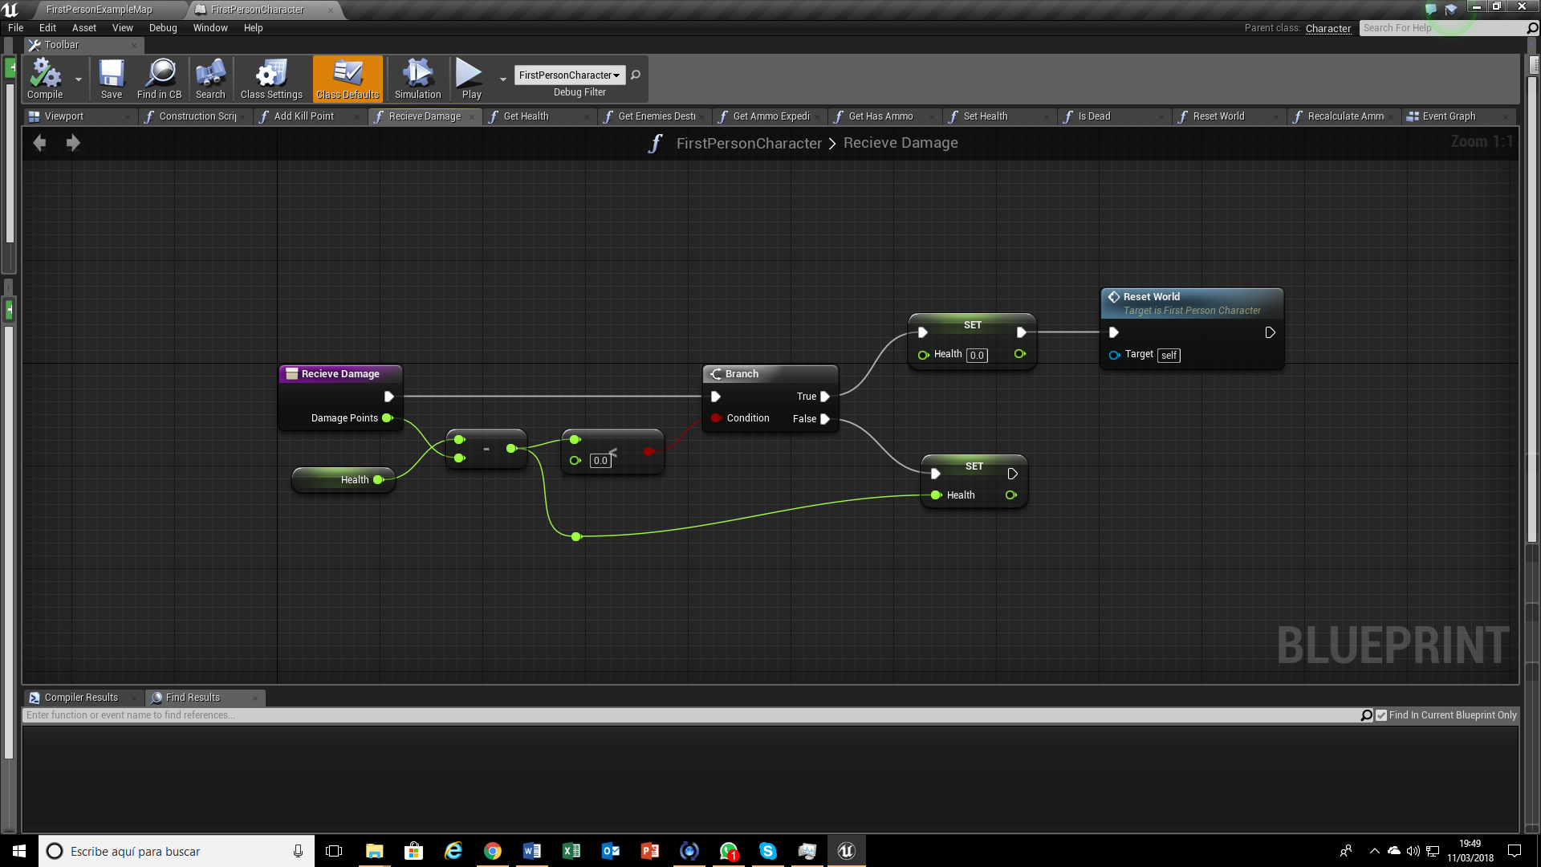
FisrtPersonCharacter modified
Receive Damage Function

Slide 16
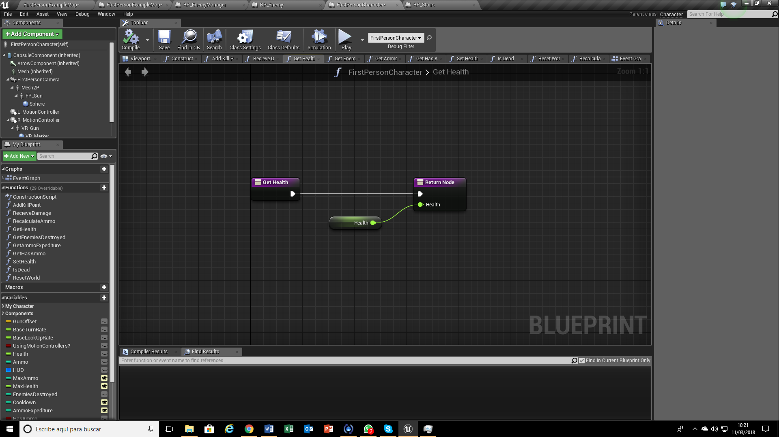
FisrtPersonCharacter modified
Get Health Function

Slide 17
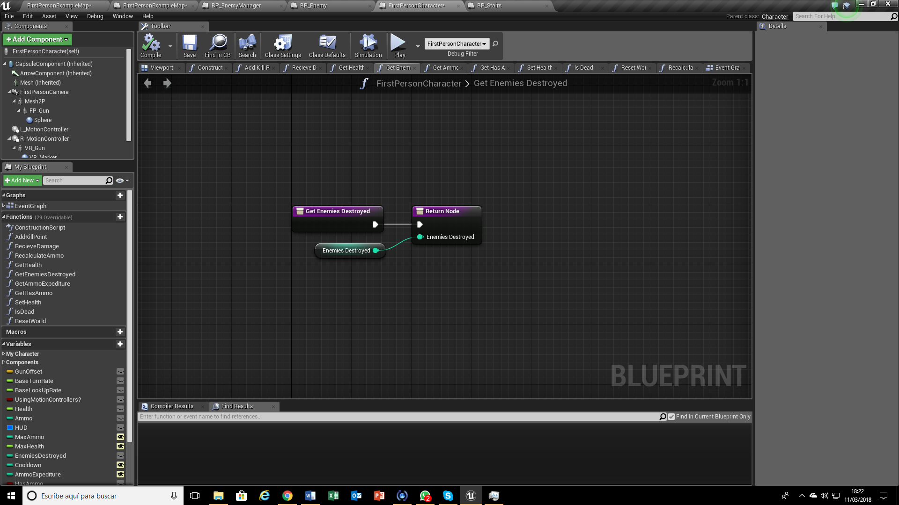
FisrtPersonCharacter modified
Get Enemies Destroyed Function

Slide 18
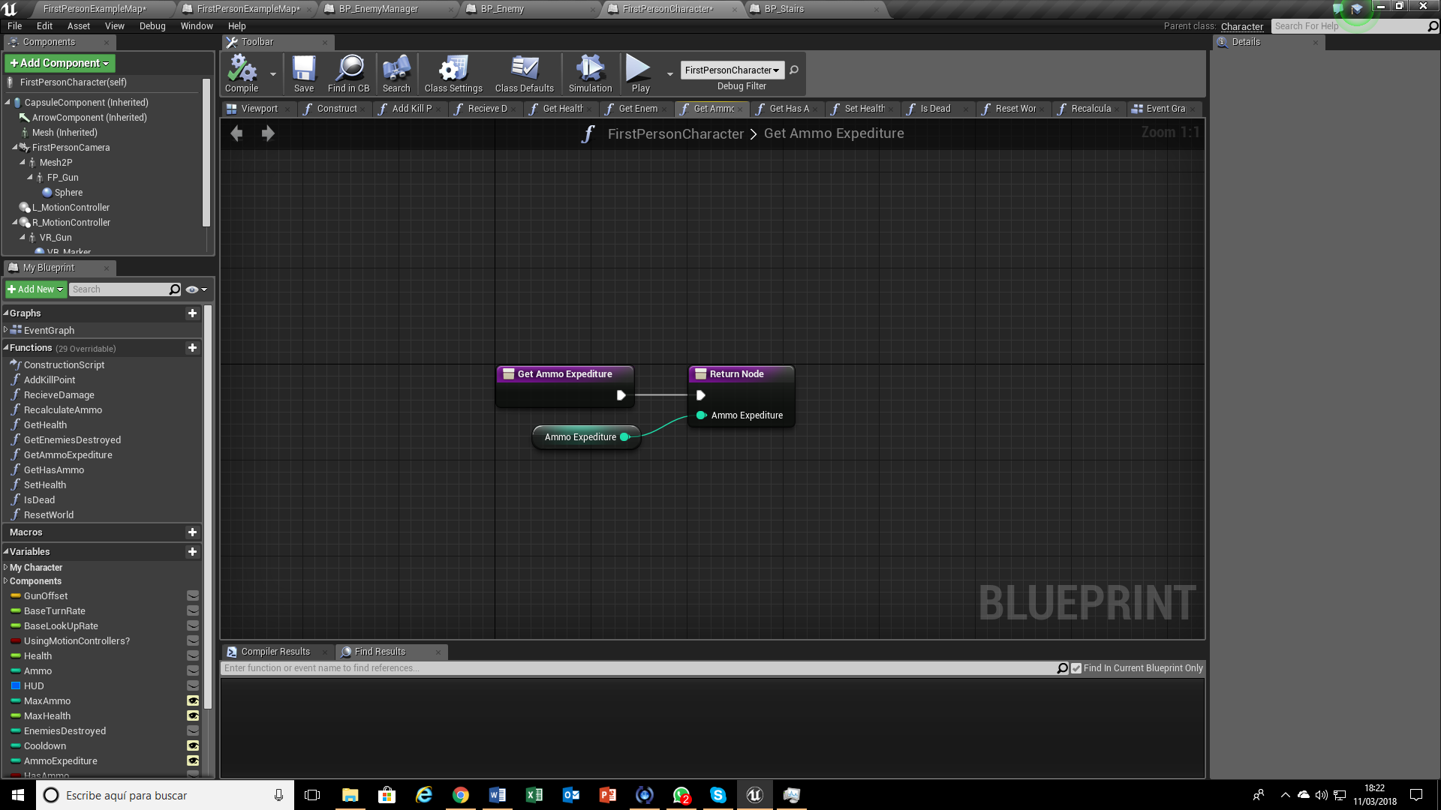
FisrtPersonCharacter modified
Get Ammo Expediture Function

Slide 19
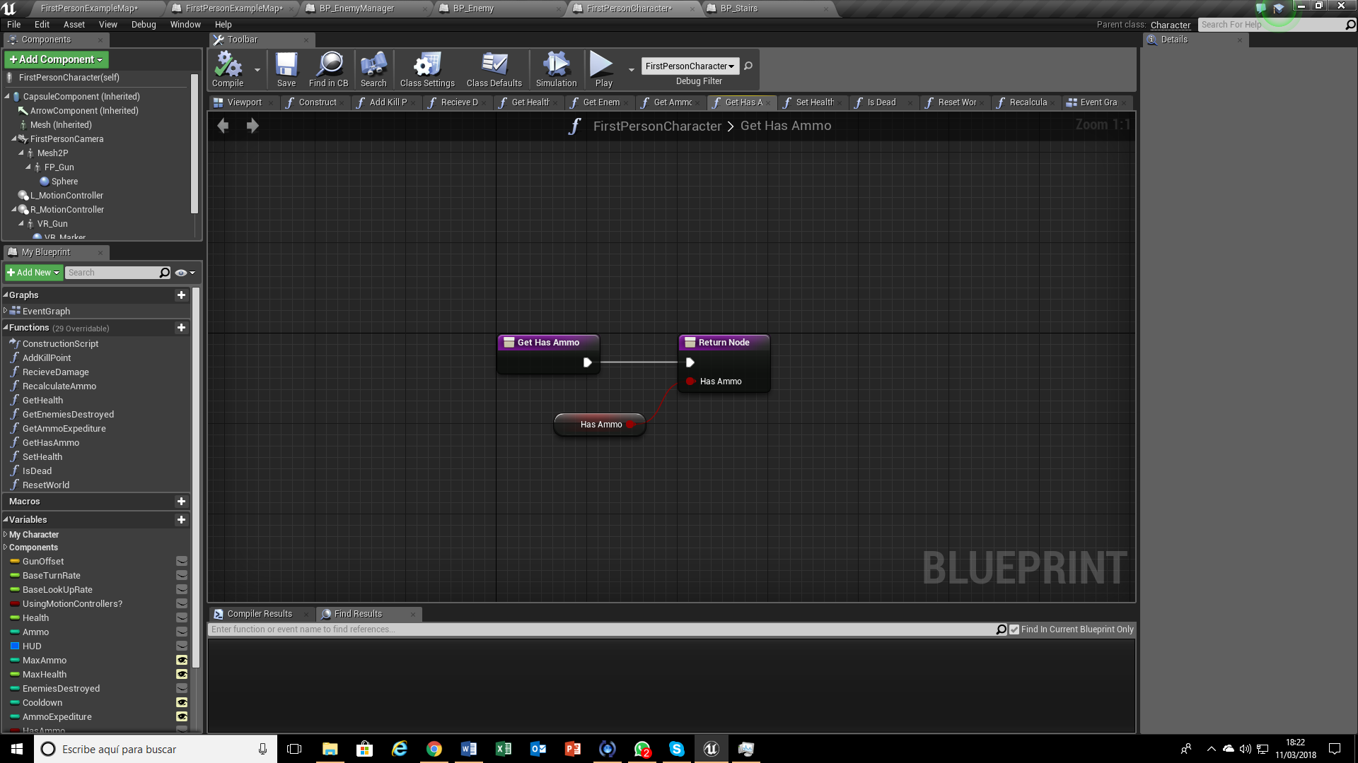
FisrtPersonCharacter modified
Get Has Ammo Function

Slide 20
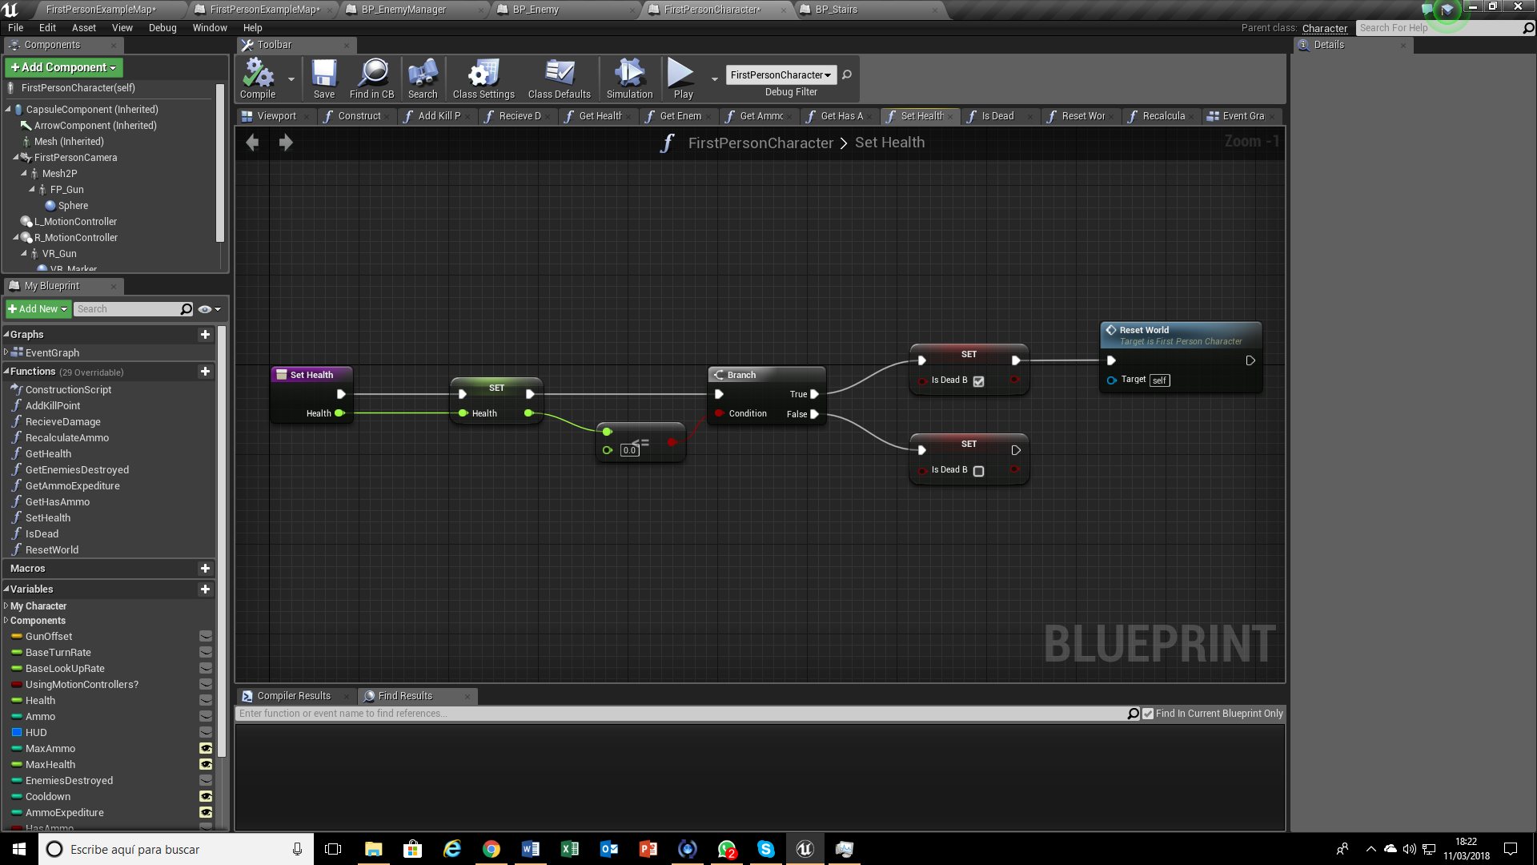
FisrtPersonCharacter modified
Set Health Function

Slide 21
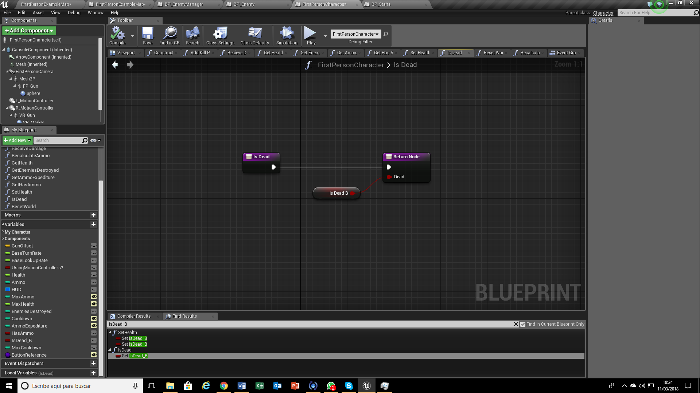
FisrtPersonCharacter modified
Is Dead Function

Slide 22
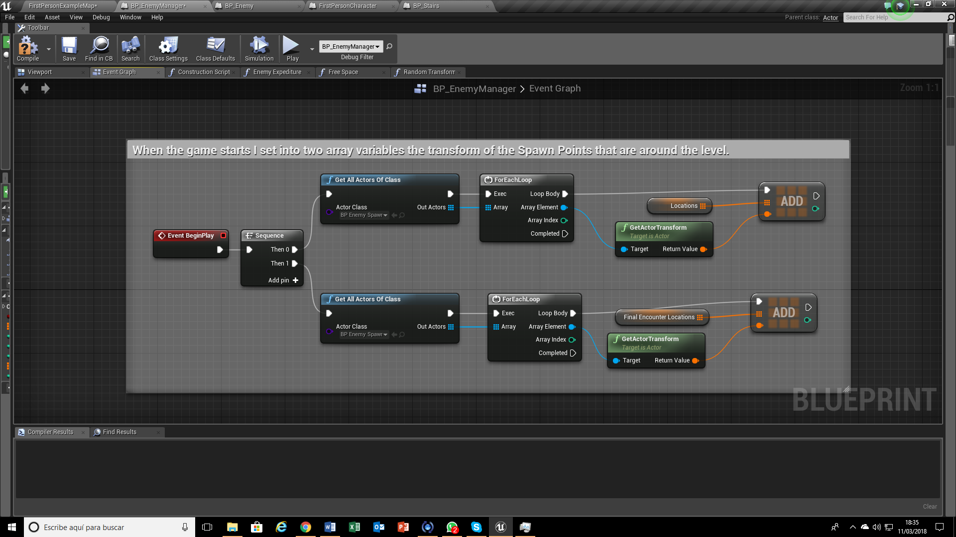
BP_EnemyManager

Slide 23
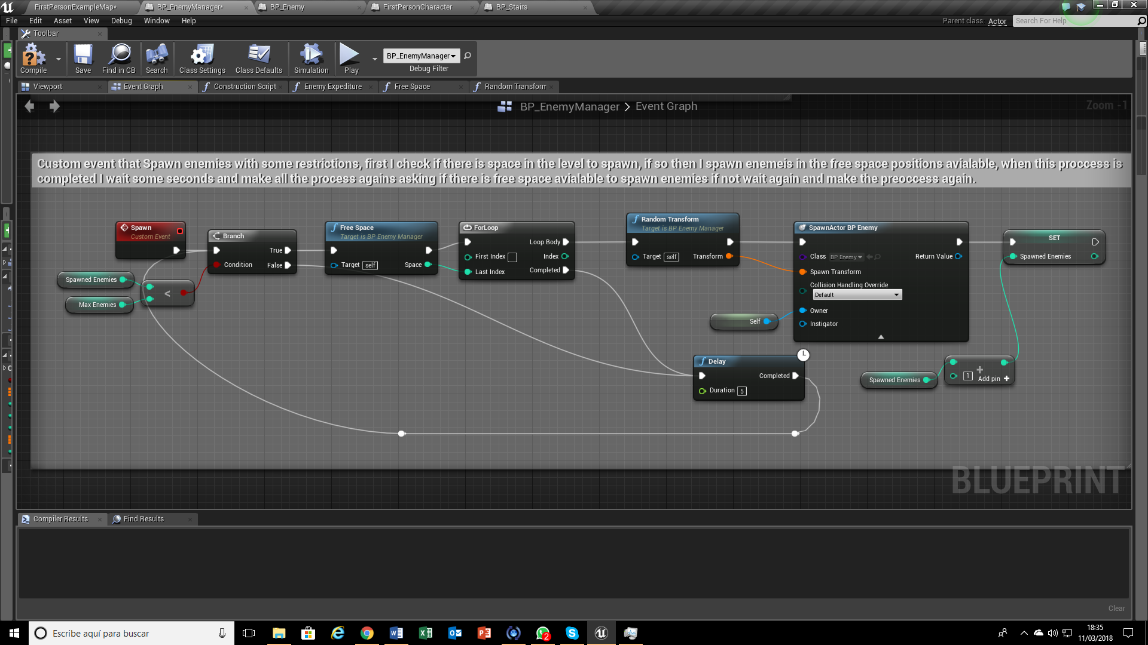
BP_EnemyManager

Slide 24
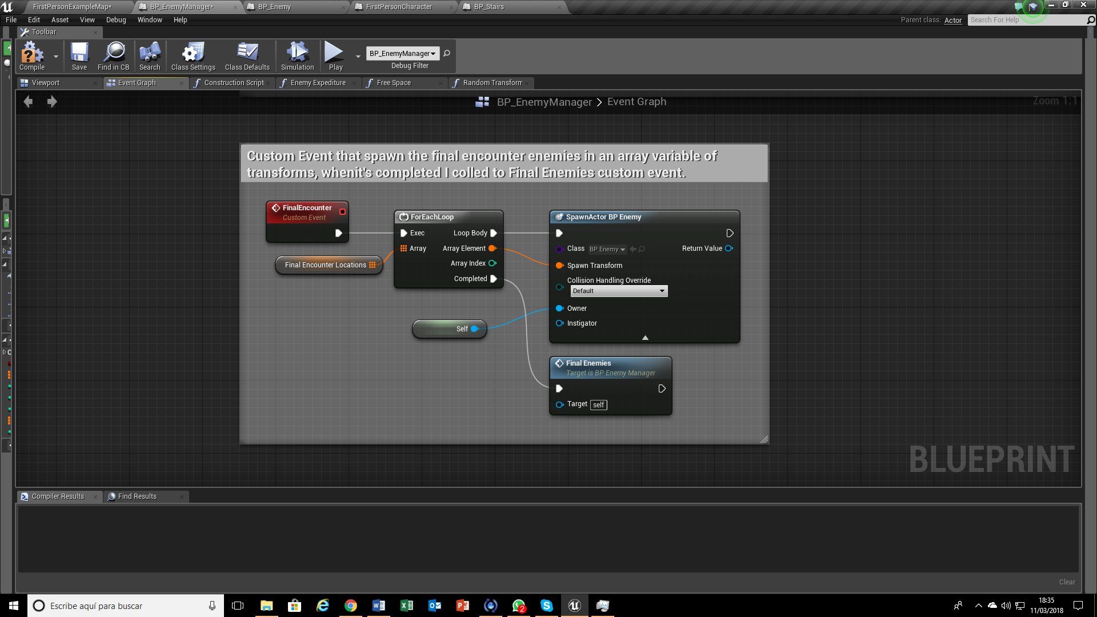
BP_EnemyManager

Slide 25
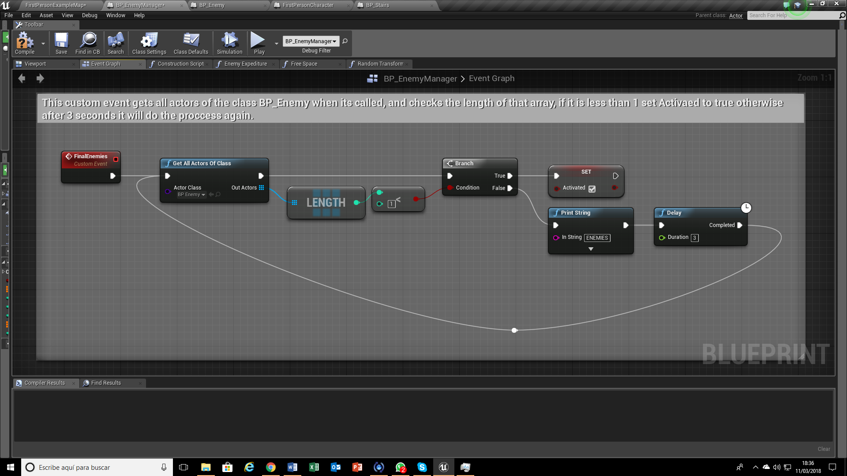
BP_EnemyManager

Slide 26
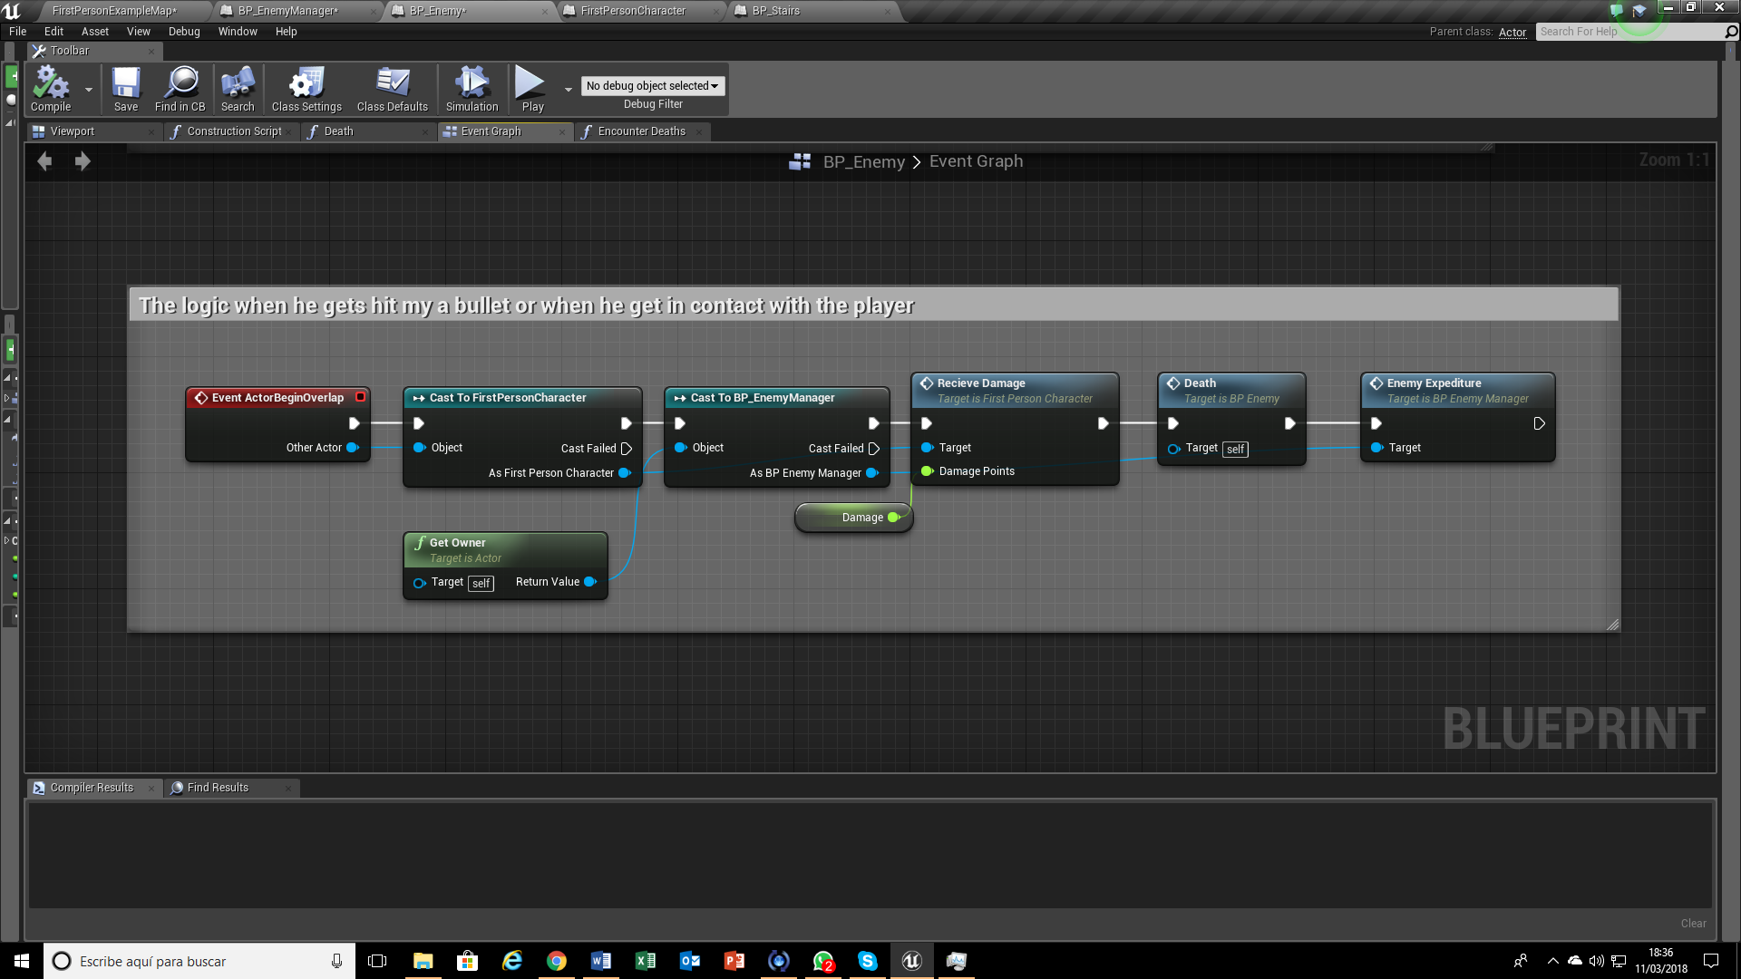
BP_Enemy

Slide 27
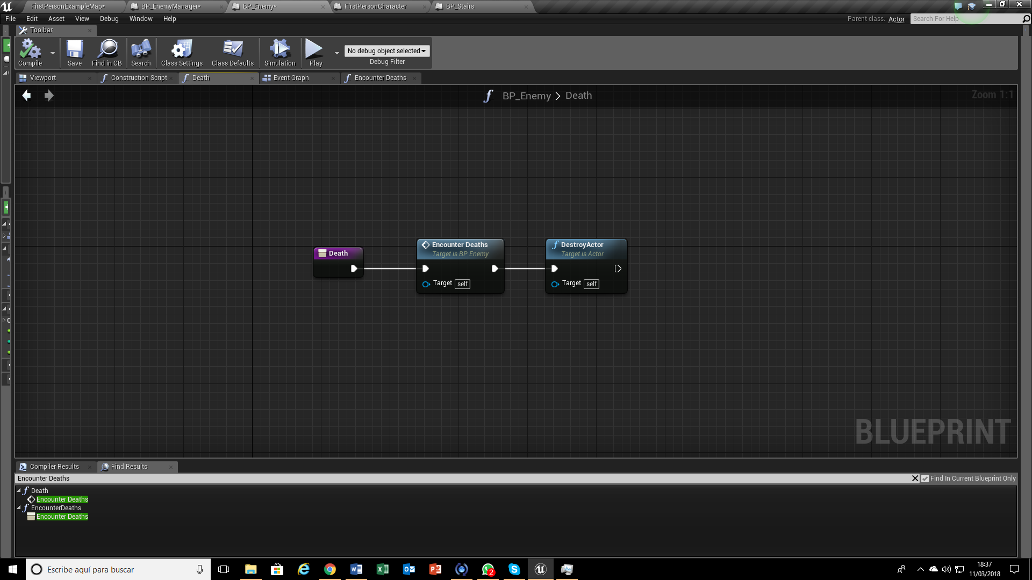
BP_Enemy
Death Function

Slide 28
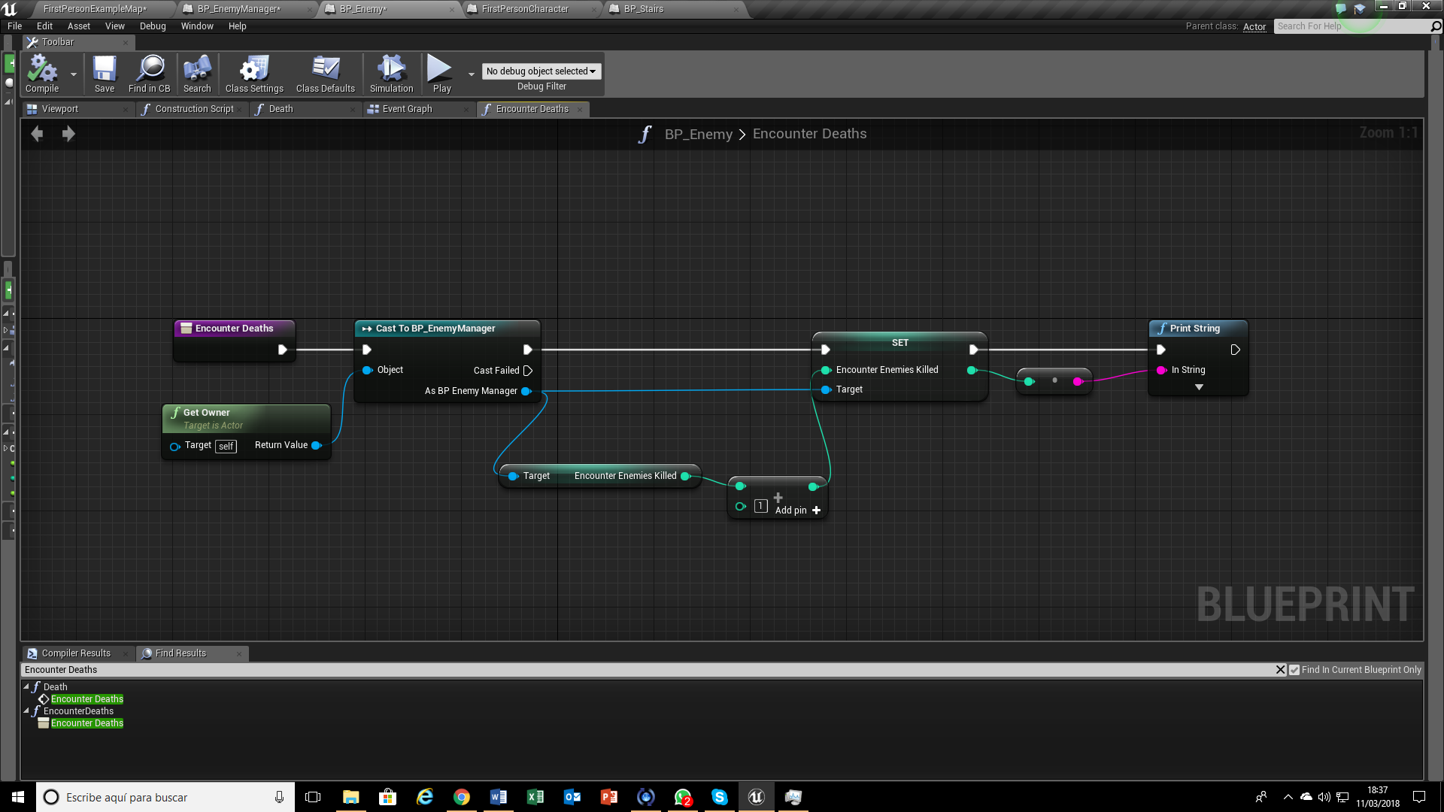
BP_Enemy
Encounter Deaths Function

Slide 29
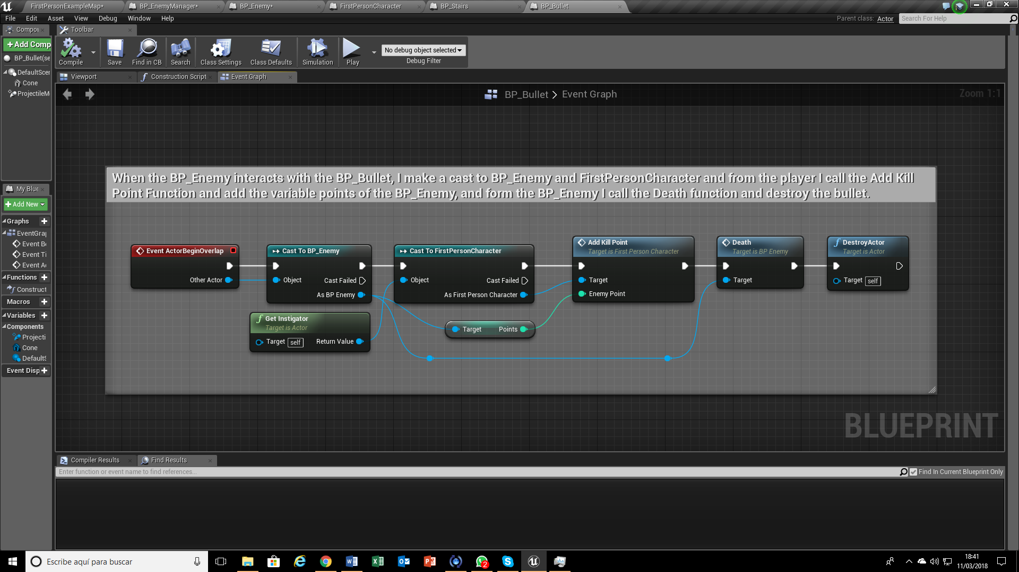
BP_Bullet

Slide 30
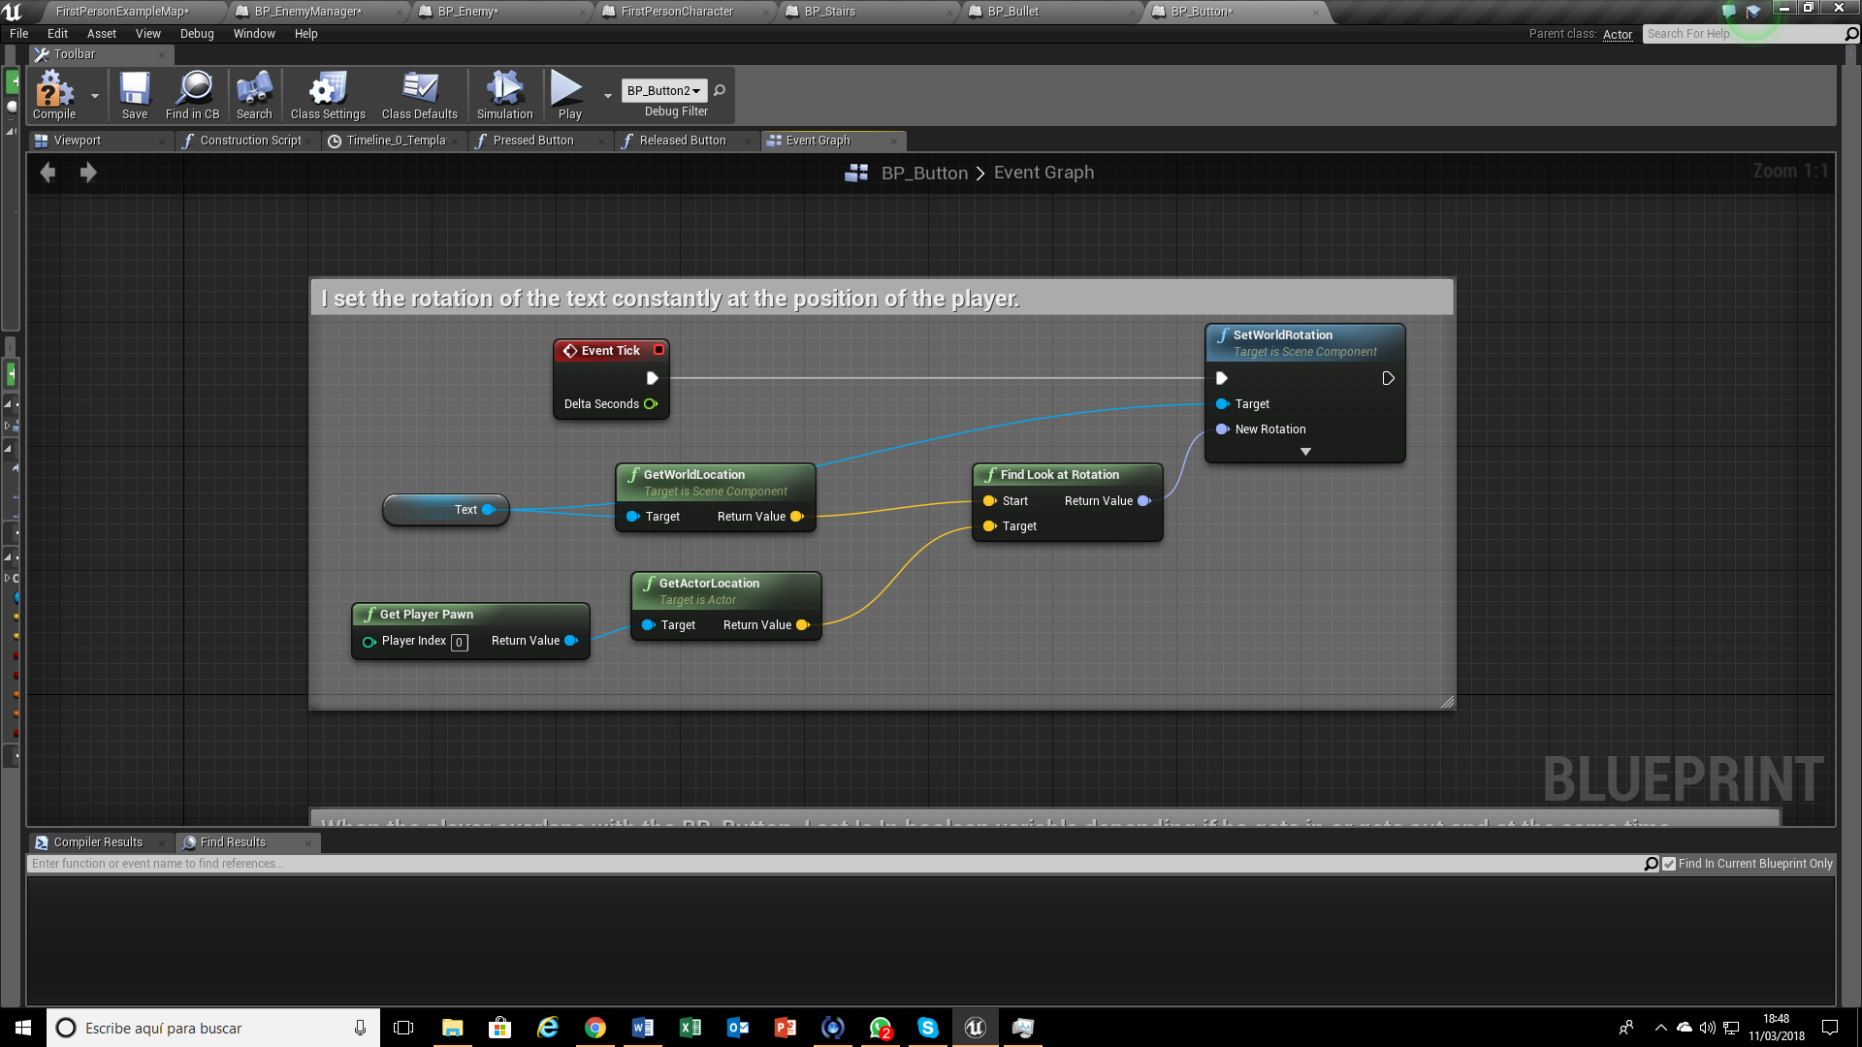
BP_Button

Slide 31
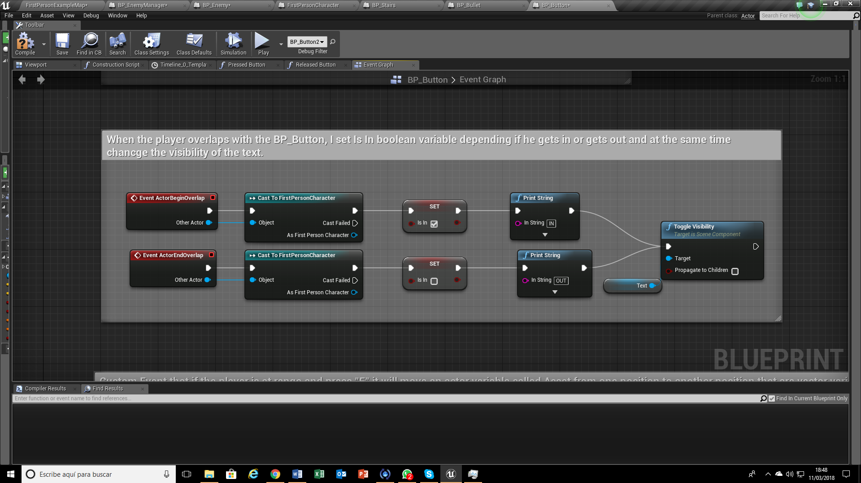
BP_Button

Slide 32
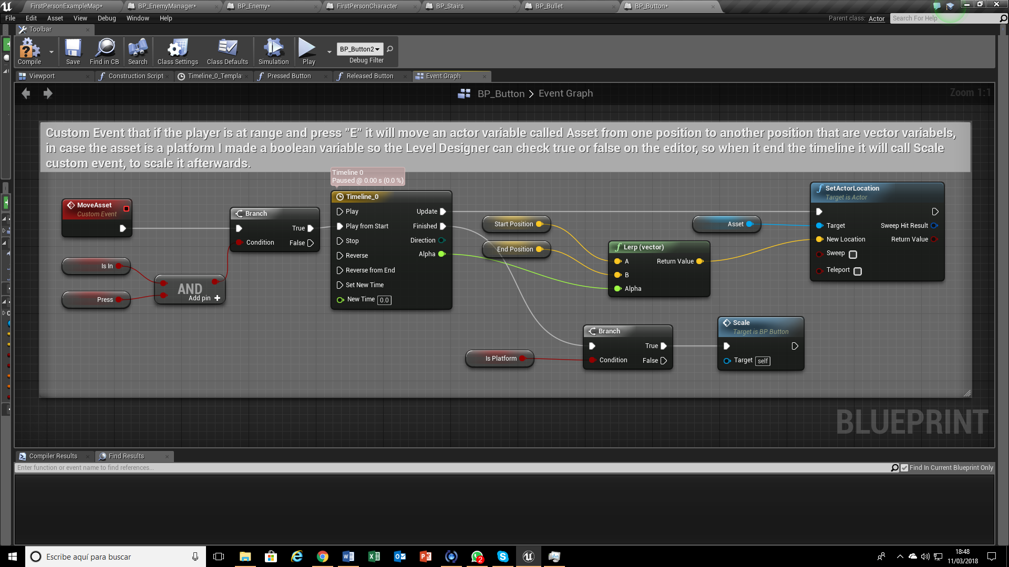
BP_Button

Slide 33
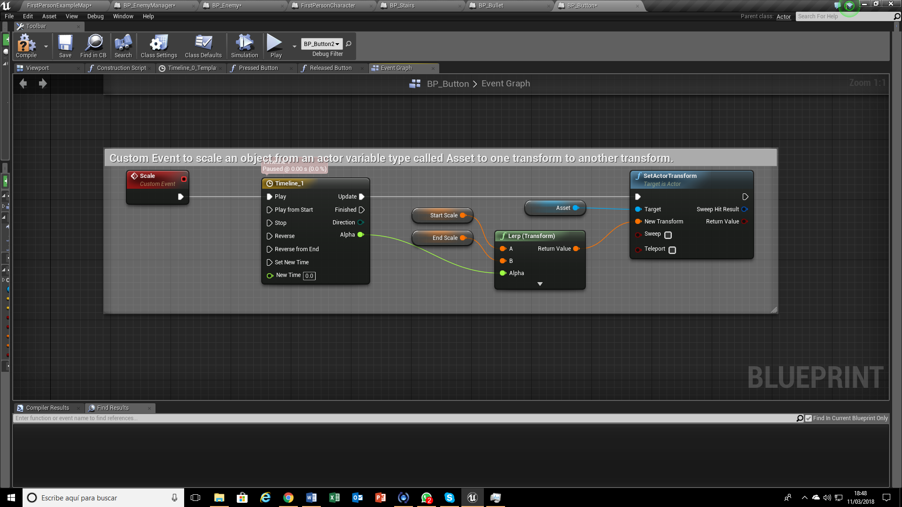
BP_Button

Slide 34
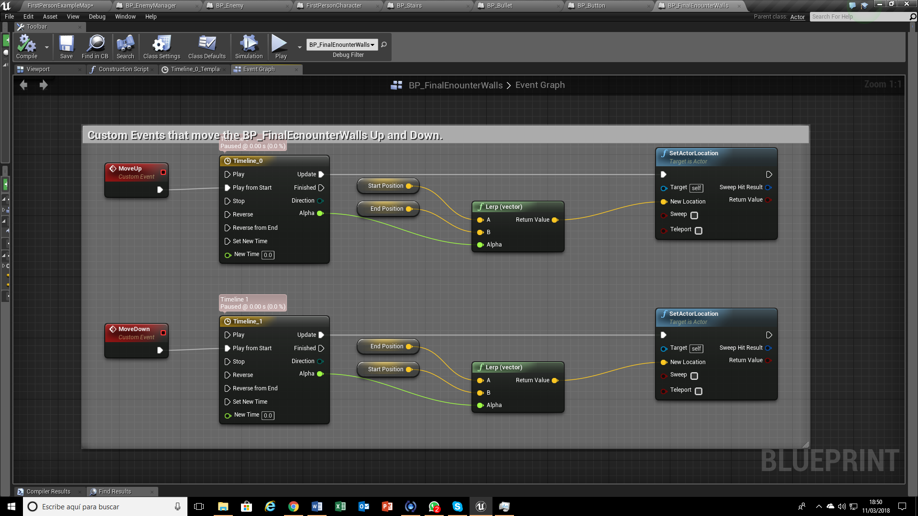
BP_FinalEncounterWalls

Slide 35
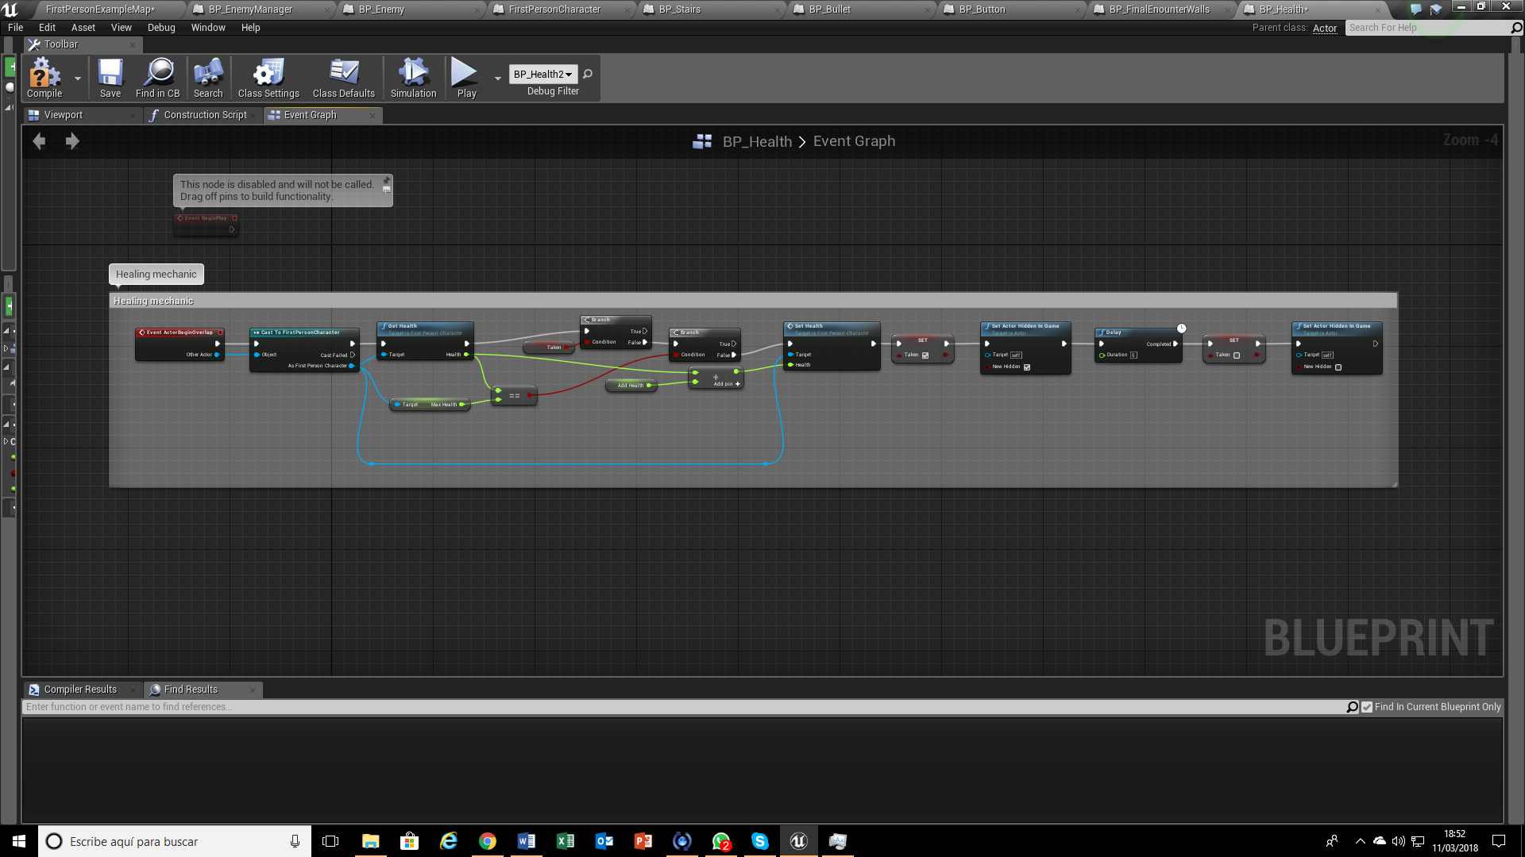
BP_Health

Slide 36
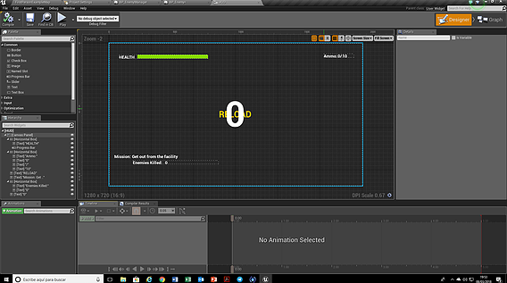
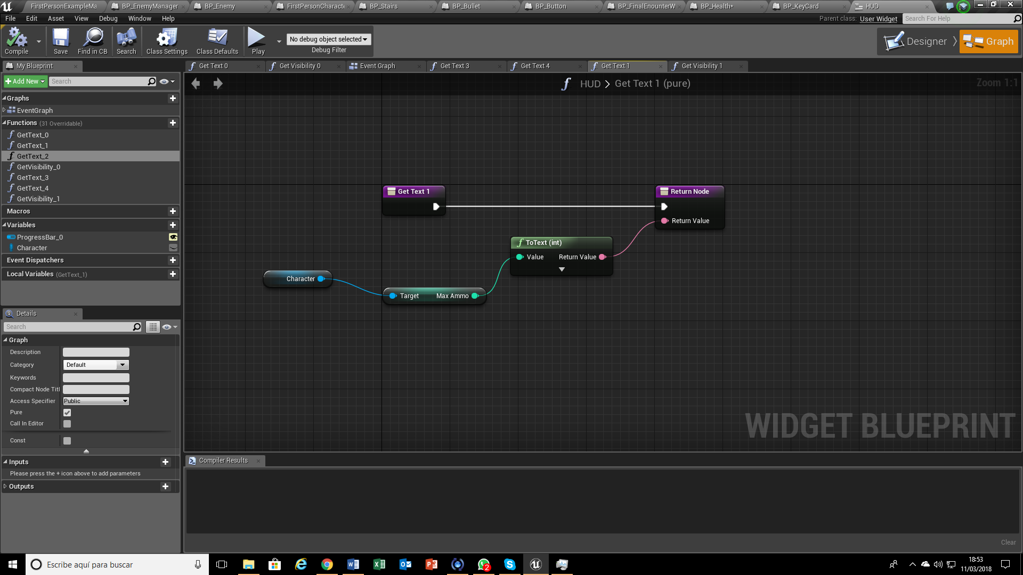
BP_Health
In the canvas of the game, I bind every aspect that I’m going to update constantly into the viewport, creating a function from the variables of the FirstPersonCharacter

